Slide 1




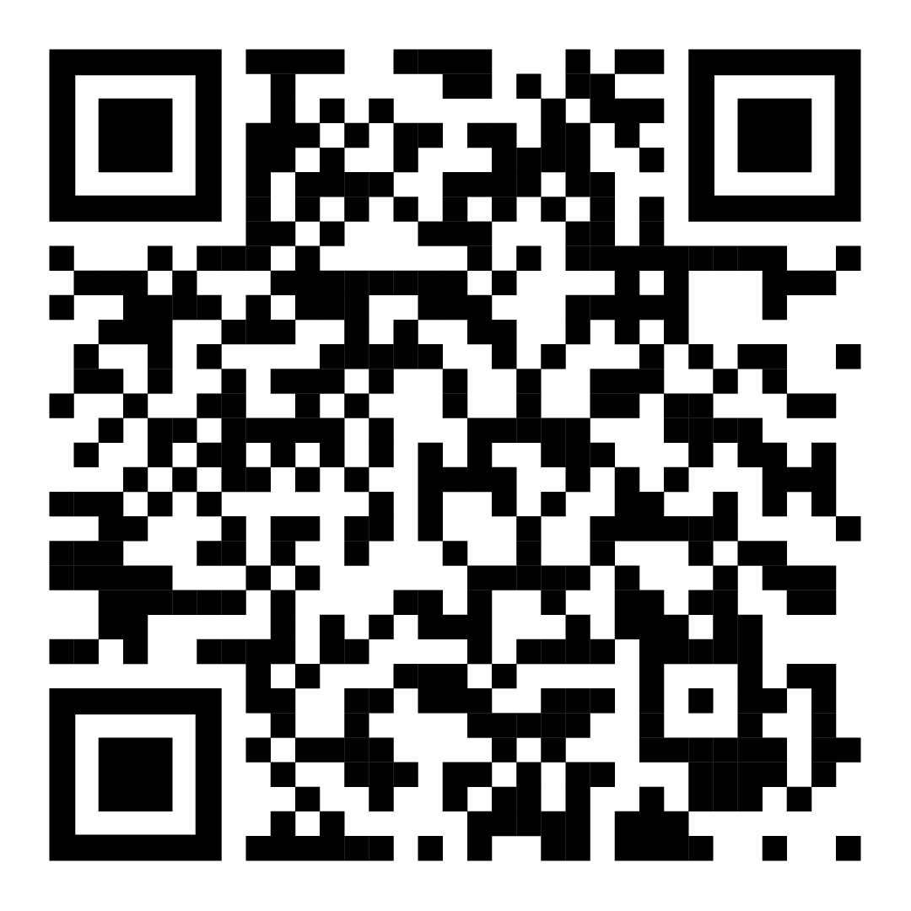
The INEQE Safeguarding Group is an independent company
of safeguarding professionals.
We have been asked to carry out Audits of the Church of England
to make sure dioceses, cathedrals and palaces are doing all they can to create environments where everyone feels safe, valued
and respected.
Listening to and learning from parishes is an important part
of the Audit.
You can help us
If you have any information, concerns or worries about something that happened in or is related to your Church body, you can contact us via this webpage:
Tell us your views!
ineqe.com/churchofengland/worcester
Your participation is critically important and you can help by taking part in an anonymous and confidential survey.
We encourage you to be open and honest. We will only share information if what you tell us indicates a serious risk of harm.
Closing date is 1st May 2024
Don’t forget - If you or someone you know is in immediate danger, it is important that you quickly get the right help – call the police on 999
ineqe.com/churchofengland/worcester
NSPCC Helpline
Helpline - 080 8800 5000
Email - help@NSPCC.org.uk
Safe Spaces Support Service
Helpline - 030 0303 1056
Email - safespaces@firstlight.org.uk
Web - safespacesenglandandwales.org.uk
Childline
Helpline - 0800 1111
Web - childline.org.uk
© Ineqe Group Ltd 2024
Parish
© Ineqe Group Ltd 2024
Access the webpage by scanning the QR code
ineqe.com/churchofengland/worcester

Slide 2
The INEQE Safeguarding Group is an independent company
of safeguarding professionals.
We have been asked to carry out Audits of the Church of England
to make sure dioceses, cathedrals and palaces are doing all they can to create environments where everyone feels safe, valued
and respected.
Listening to and learning from parishes is an important part
of the Audit.
You can help us
If you have any information, concerns or worries about something that happened in or is related to your Church body, you can contact us via this webpage:
Tell us your views!
ineqe.com/churchofengland/worcester
Your participation is critically important and you can help by taking part in an anonymous and confidential survey.
We encourage you to be open and honest. We will only share information if what you tell us indicates a serious risk of harm.
Closing date is 1st May 2024
Don’t forget - If you or someone you know is in immediate danger, it is important that you quickly get the right help – call the police on 999
ineqe.com/churchofengland/worcester
NSPCC Helpline
Helpline - 080 8800 5000
Email - help@NSPCC.org.uk
Safe Spaces Support Service
Helpline - 030 0303 1056
Email - safespaces@firstlight.org.uk
Web - safespacesenglandandwales.org.uk
Childline
Helpline - 0800 1111
Web - childline.org.uk
Access the webpage by scanning the QR code
ineqe.com/churchofengland/worcester
Parish
© Ineqe Group Ltd 2024
Notes:
EDIT NOTES <
QR Code will need changed to correct URL Linkv
Change URL for QR Code box, for Tell us your views button and for you can help us button

