Slide 1
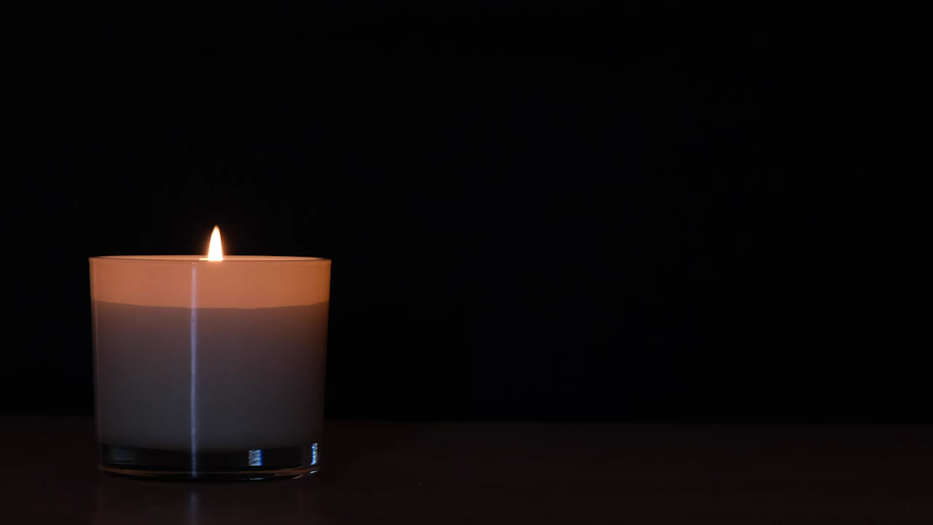
From
LITURGY to
LIFE
Blessed
and blessing

Slide 2
God in Christ has revealed his glory.
Come let us worship.
From the rising of the sun to its setting
the Lord’s name is greatly to be praised.
Give him praise, you servants of the Lord.
O praise the name of the Lord!
Let us pray.
Come, Holy Spirit,
fill the hearts of your faithful people,
and kindle in us the fire of your love;
through Jesus Christ our Lord.
Amen.

Slide 3
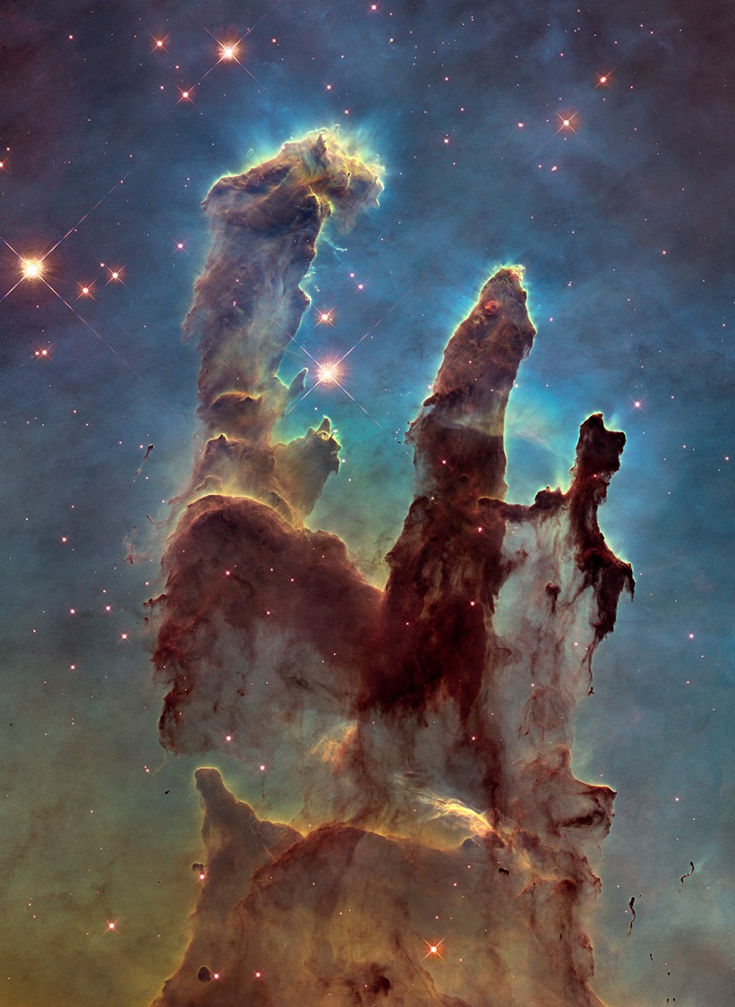
Creation
For he is your living Word;
through him you have created all things from the beginning,
and formed us in your own image. (A)
You are worthy of our thanks and praise Lord God of truth,
for by the breath of your mouth you have spoken your Word,
and all things have come into being.
You fashioned us in your image
and placed us in the garden of your delight. (F)
From the beginning you have created all things
and all your works echo the silent music of your praise.
In the fullness of time you made us in your image,
the crown of all creation. (G)

Slide 4
Creation
He is the image of the invisible God, the firstborn of all creation; for in him all things in heaven and on earth were created, things visible and invisible, whether thrones or dominions or rulers or powers—all things have been created through him and for him. He himself is before all things, and in him all things hold together. (Col 1:15-17)
All things came into being through him, and without him not one thing came into being. What has come into being in him was life, and the life was the light of all people. … The true light, which enlightens everyone, was coming into the world. (Jn 1:3,4,9)
John1:9 can also be translated: “This was the true light who enlightens everyone who comes into the world.”

Slide 5
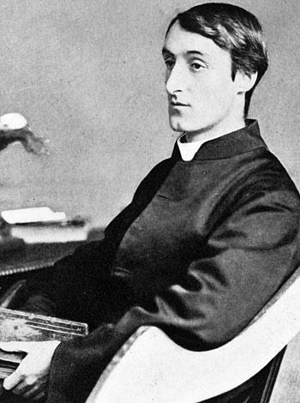
God’s Grandeur
The world is charged with the grandeur of God.
It will flame out, like shining from shook foil;
It gathers to a greatness, like the ooze of oil
Crushed. Why do men then now not reck his rod?
Generations have trod, have trod, have trod;
And all is seared with trade; bleared, smeared with toil;
And wears man's smudge and shares man's smell: the soil
Is bare now, nor can foot feel, being shod.
And for all this, nature is never spent;
There lives the dearest freshness deep down things;
And though the last lights off the black West went
Oh, morning, at the brown brink eastward, springs —
Because the Holy Ghost over the bent
World broods with warm breast and with ah! bright wings.

Slide 6
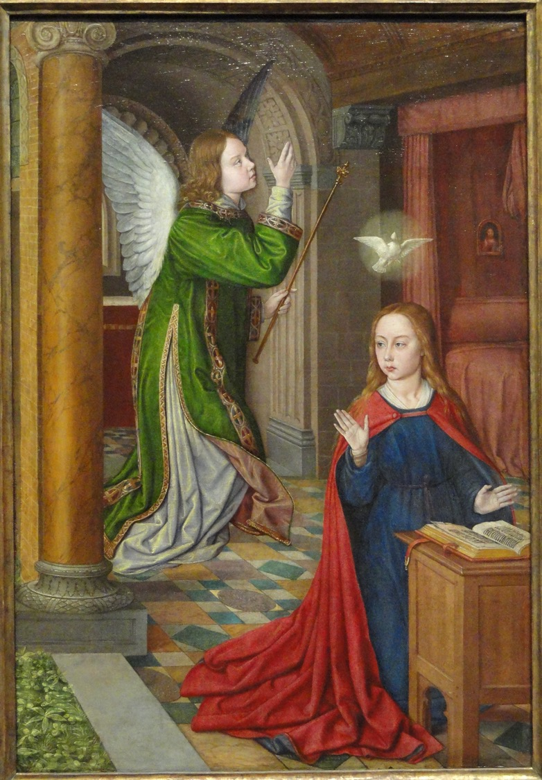
Incarnation
By the power of the Holy Spirit he took flesh;
as your Son, born of the blessed Virgin,
he lived on earth and went about among us; (B)
yet in the coming of your Son Jesus Christ,
you reveal the power of your love
made perfect in our human weakness.
Embracing our humanity,
Jesus showed us the way of salvation.(F)
When we turned away you did not reject us,
but came to meet us in your Son.
You embraced us as your children
and welcomed us to sit and eat with you.
In Christ you shared our life
that we might live in him and he in us. (H)

Slide 7
Incarnation
For you know the generous act of our Lord Jesus Christ, that though he was rich, yet for your sakes he became poor, so that by his poverty you might become rich. (2 Cor 8:9)
Christ Jesus, who, though he was in the form of God, did not regard equality with God as something to be exploited, but emptied himself, taking the form of a slave, being born in human likeness. (Phil 2:6-7)
Since, therefore, the children share flesh and blood, he himself likewise shared the same things, so that through death he might destroy the one who has the power of death, …Therefore he had to become like his brothers and sisters in every respect. (Heb 2:14,15,17)

Slide 8
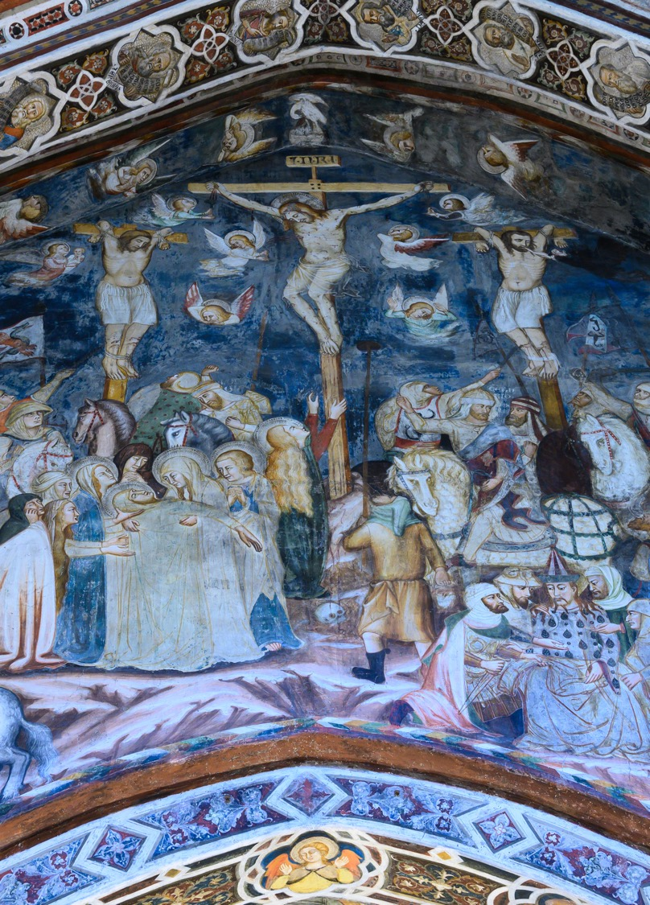
Glorification
we remember now his offering of himself made once for all upon the cross, we proclaim his mighty resurrection and glorious ascension (A)
And so, Father, calling to mind his death on the cross, his perfect sacrifice made once for the sins of the whole world; rejoicing in his mighty resurrection and glorious ascension (B)
Father, we plead with confidence his sacrifice made once for all upon the cross; we remember his dying and rising in glory, and we rejoice that he intercedes for us at your right hand (G)

Slide 9
Glorification
I have been crucified with Christ; and it is no longer I who live, but it is Christ who lives in me. And the life I now live in the flesh I live by faith in the Son of God, who loved me and gave himself for me. (Gal 2:19-20)
So if you have been raised with Christ, seek the things that are above, where Christ is, seated at the right hand of God. (Col 3:1)
But when Christ came as a high priest of the good things that have come, … he entered once for all into the Holy Place, not with the blood of goats and calves, but with his own blood, thus obtaining eternal redemption. (Heb 9:11-12)

Slide 10
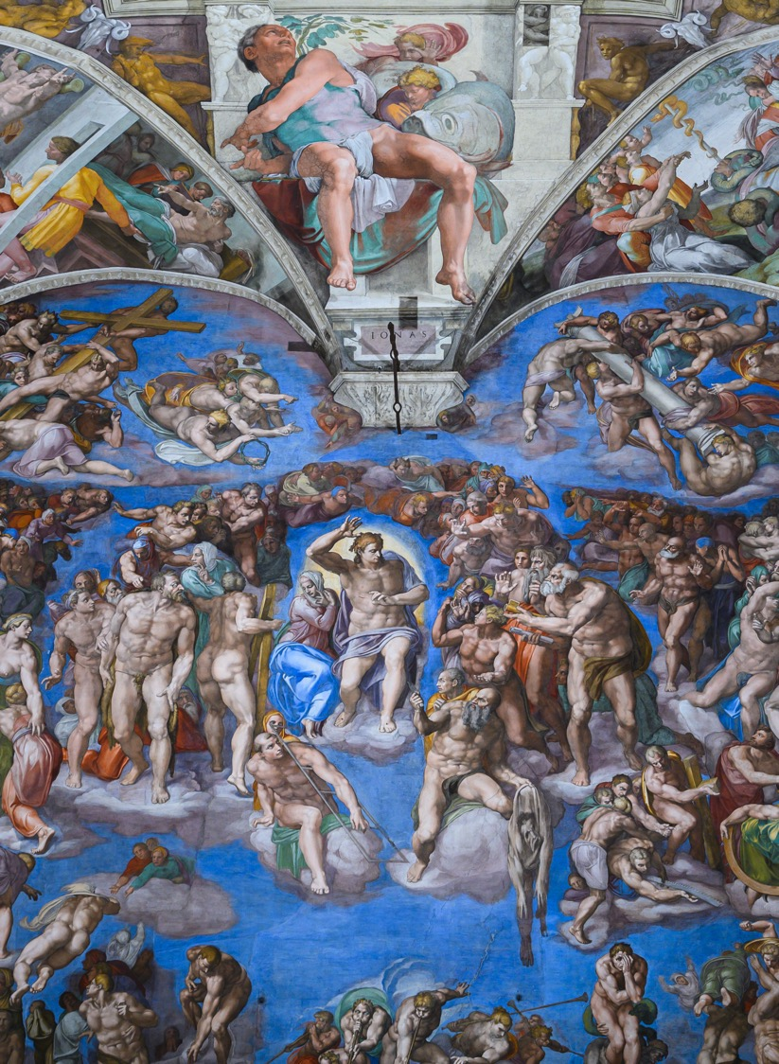
Kingdom
Lord of all life, help us to work together for that day when your kingdom comes, and justice and mercy will be seen in all the earth (E)
Gather your people from the ends of the earth
to feast with (N and) all your saints
at the table in your kingdom,
where the new creation is brought to perfection (F)
Bring us at the last with (N and) all the saints to the vision of that eternal splendour for which you have created us; through Jesus Christ our Lord (G)

Slide 11
Kingdom
The creation itself will be set free from its bondage to decay and will obtain the freedom of the glory of the children of God. (Rom 8:21)
But our citizenship is in heaven, and it is from there that we are expecting a Saviour, the Lord Jesus Christ. He will transform the body of our humiliation that it may be conformed to the body of his glory. (Phil 3:20-21)
He will dwell with them as their God; they will be his peoples, and God himself will be with them; he will wipe every tear from their eyes. Death will be no more; mourning and crying and pain will be no more, for the first things have passed away. (Rev 21:3-4)

Slide 12
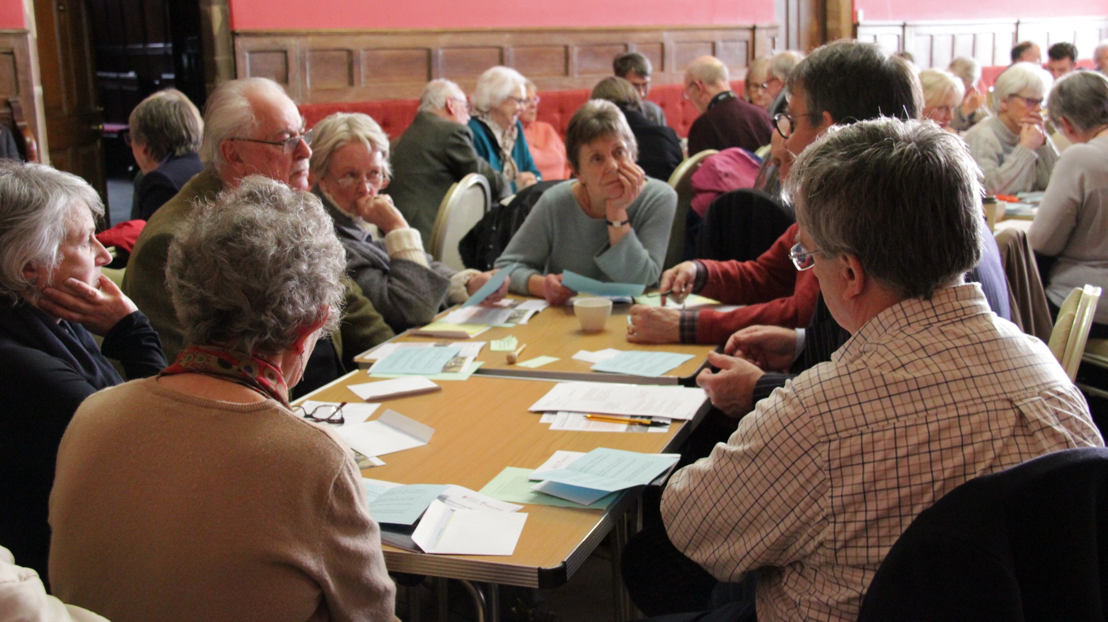
GROUPS

Slide 13
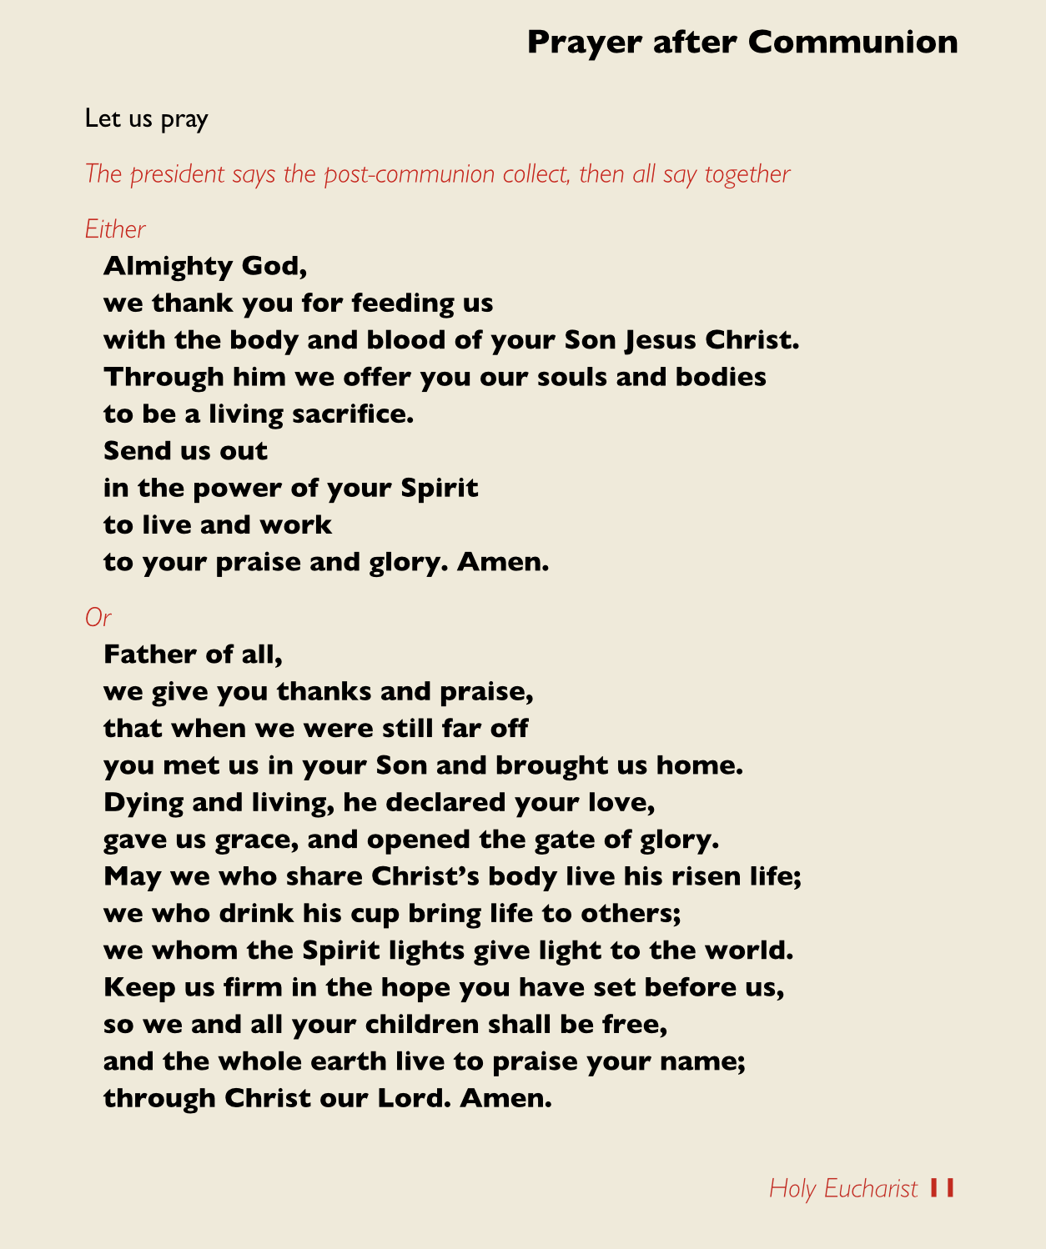

Slide 14
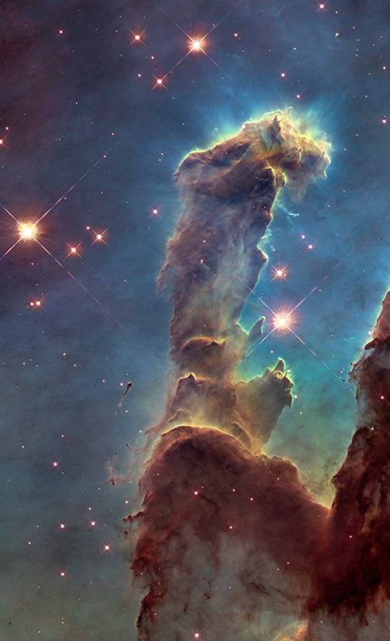
Father of all,

Slide 15
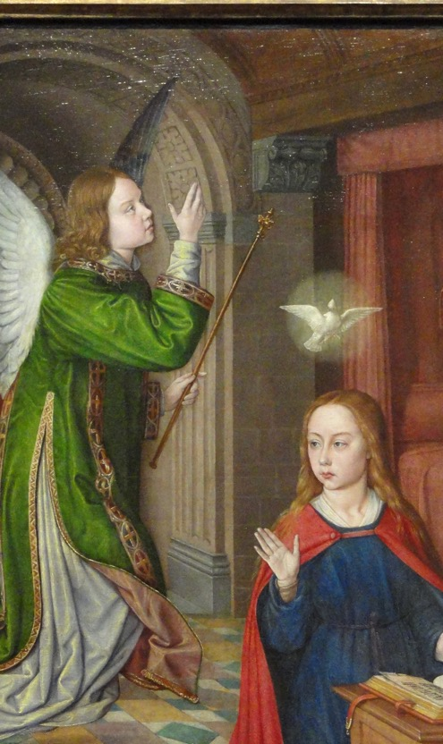
Father of all,
that when we were still far off you met us in your Son and brought us home

Slide 16
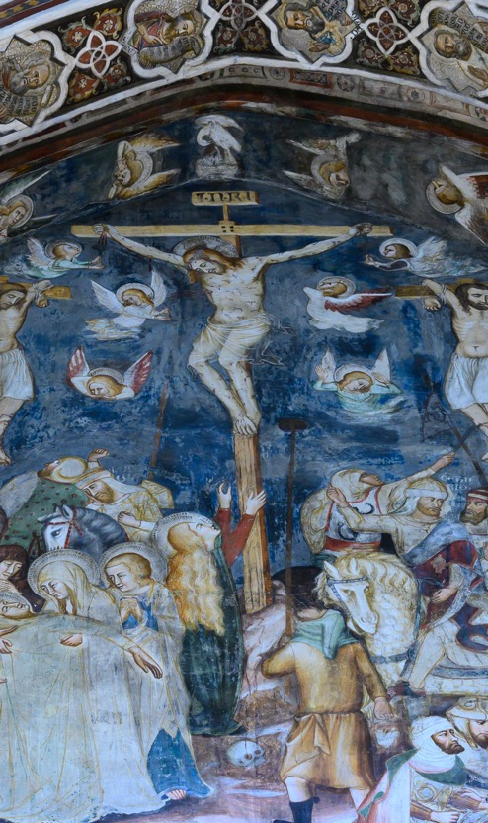
Father of all,
that when we were still far off you met us in your Son and brought us home
Dying and living, he declared your love, gave us grace, and opened the gate of glory.

Slide 17
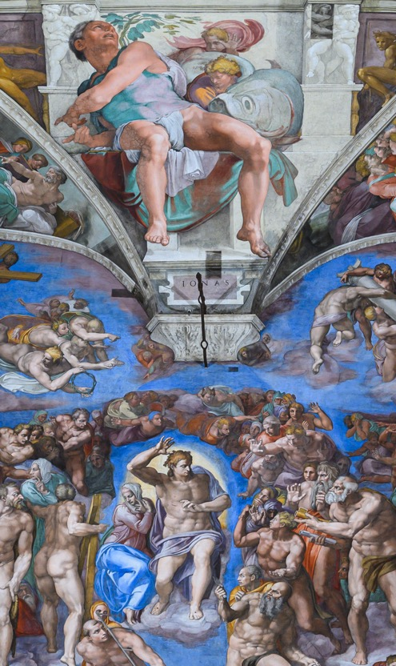
Father of all,
that when we were still far off you met us in your Son and brought us home
Dying and living, he declared your love, gave us grace, and opened the gate of glory.
so we and all your children shall be free,
and the whole earth live to praise your name

Slide 18
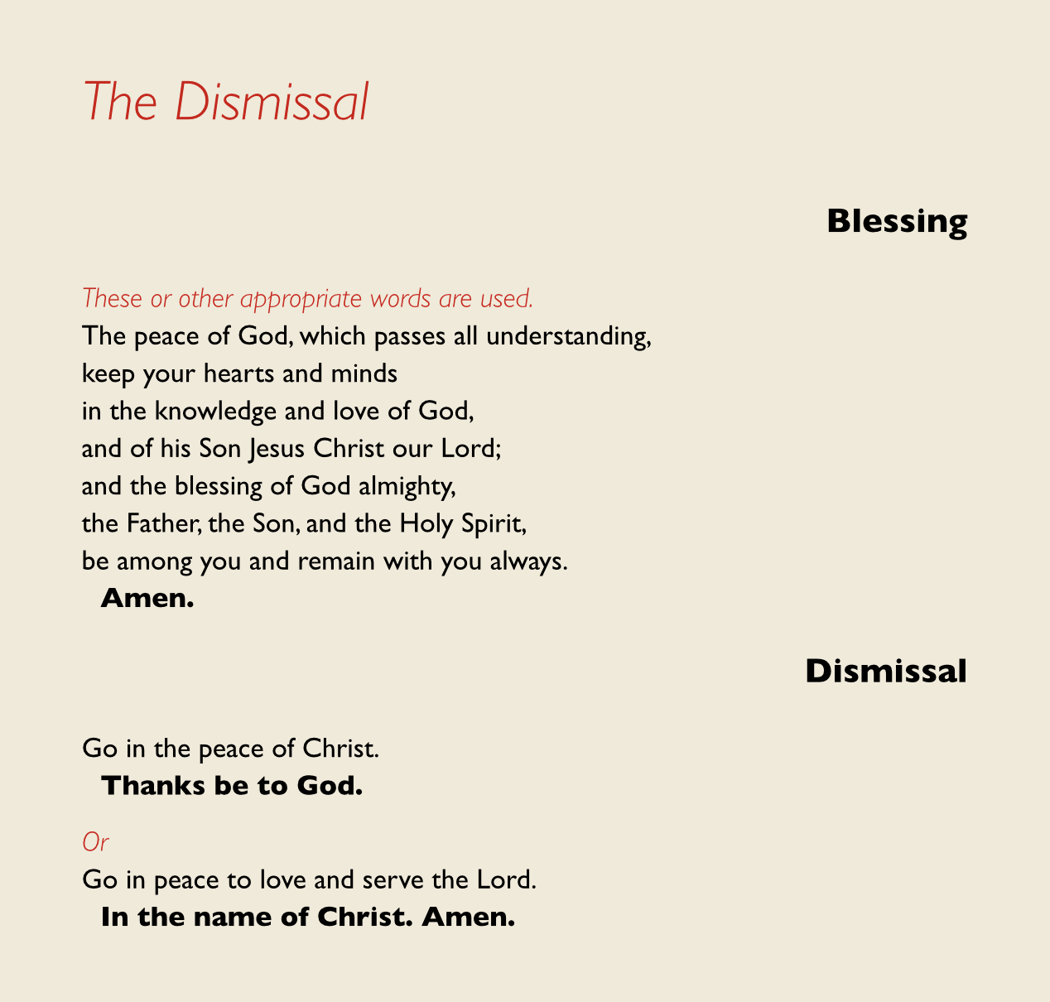

Slide 19
GROUPS

Slide 20
Jesus, lord of time,
hold us in your eternity.
Jesus, image of God,
travel with us the life of faith.
Jesus, friend of sinners,
heal the brokenness of our world.
Jesus, lord of tomorrow,
draw us into your future. Amen.
The peace of God, …
Go in peace to love and serve the Lord
In the name of Christ. Amen.

