Slide 1
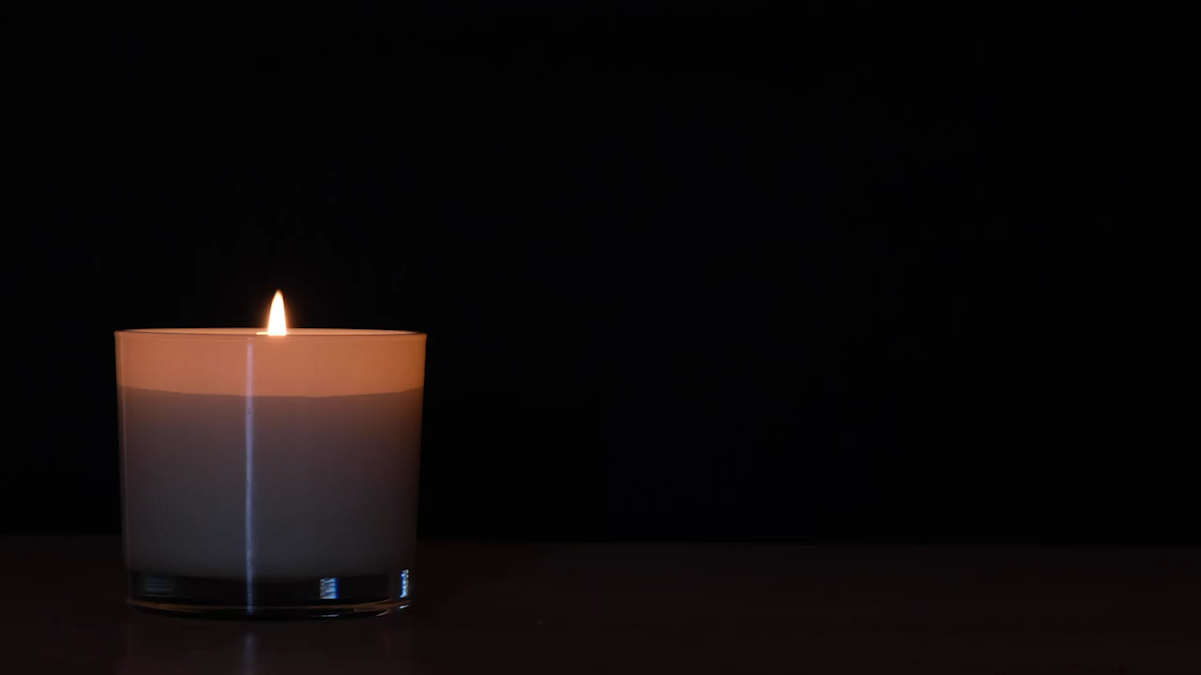
From
LITURGY to
LIFE
Transformed
with Christ

Slide 2
We meet in the presence of God
who knows our needs,
hears our cries,
feels our pain,
and heals our wounds.
God of our days and years,
we set this time apart for you.
Form us in the likeness of Christ
so that our lives may glorify you.
The Lord be with you
and also with you.

Slide 3
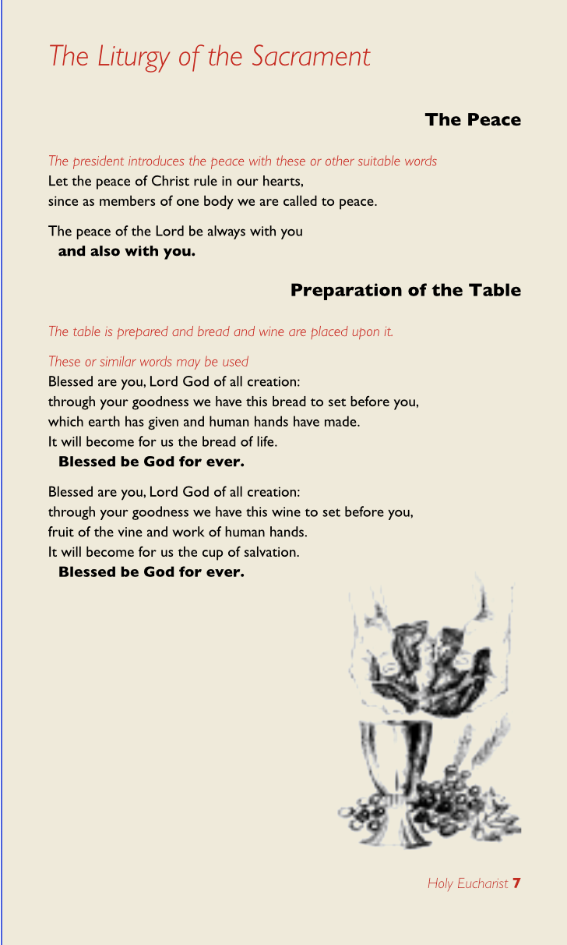
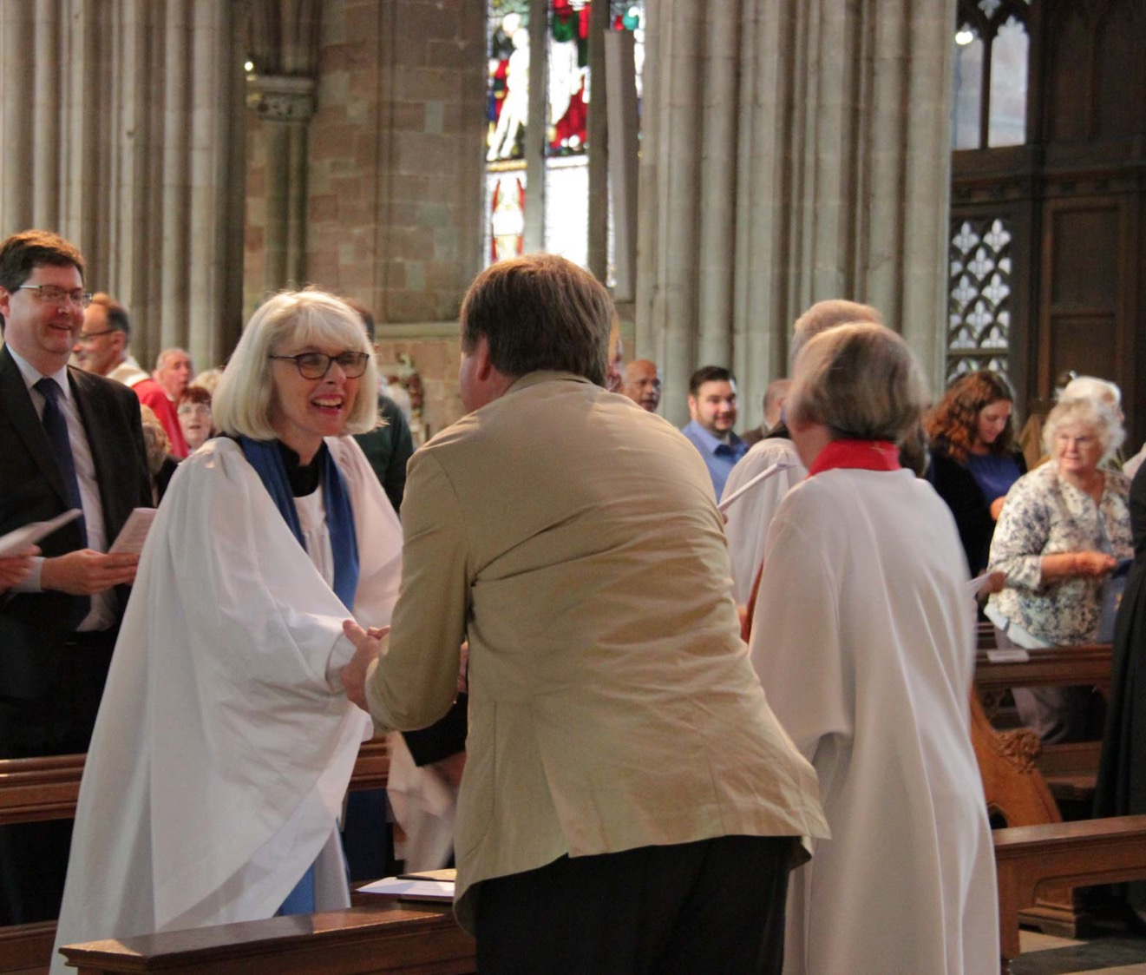

Slide 4
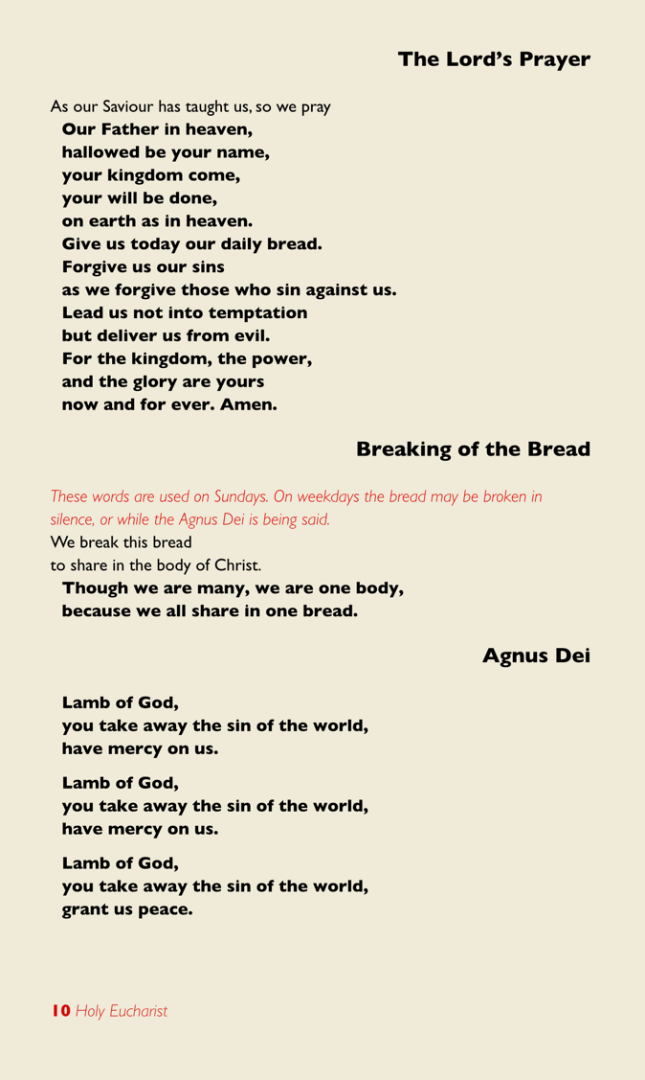

“the seal of prayer” – Mt 18:19?
Mt 5:23-24 “So when you are offering your gift at the altar …”
Mt 6:14 “For if you forgive others
their trespasses, your heavenly
Father will also forgive you;”

Slide 5
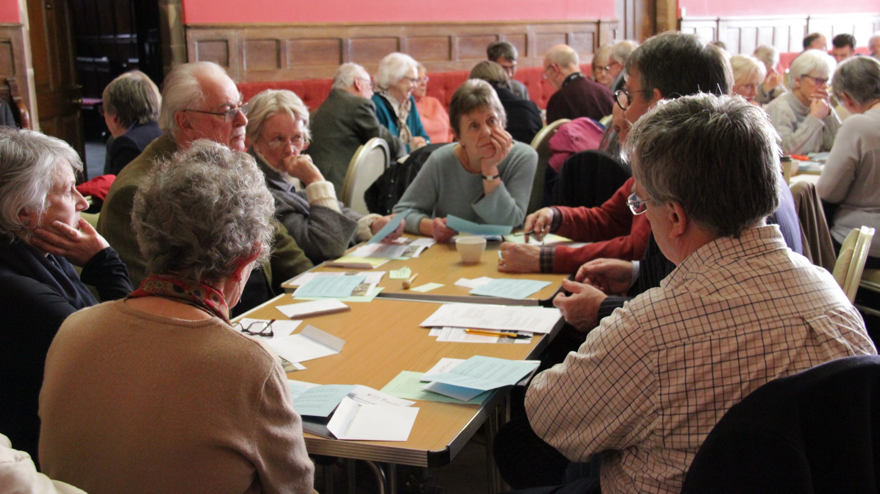
GROUPS

Slide 6
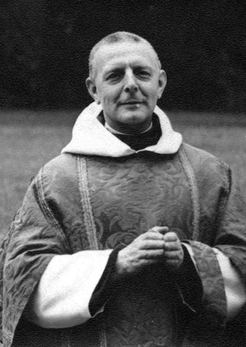
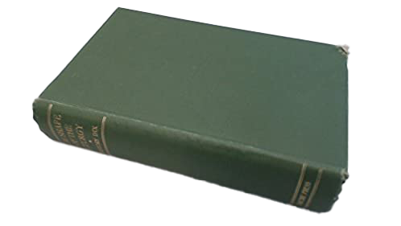
There is a common shape to early Christian liturgy
Dom Gregory Dix (1901-1952)

Slide 7
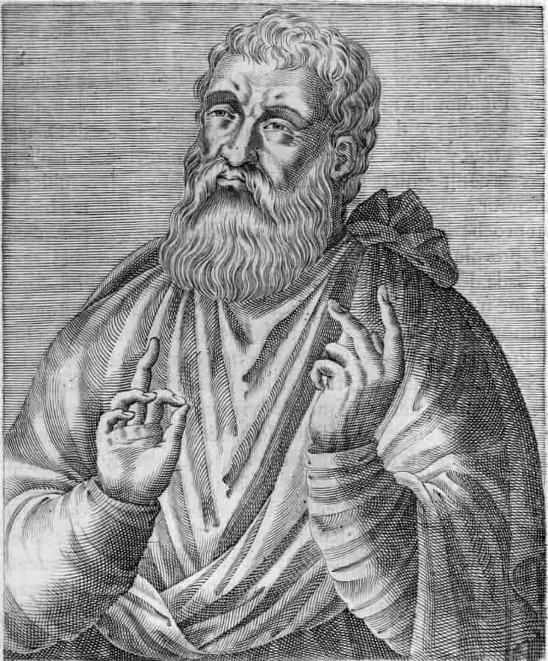
And on the day called Sunday, all who live in cities or in the country gather together to one place, and the memoirs of the apostles or the writings of the prophets are read, as long as time permits; then, when the reader has ceased, the president verbally instructs, and exhorts to the imitation of these good things. Then we all rise together and pray, and, as we before said, when our prayer is ended, bread and wine and water are brought, and the president in like manner offers prayers and thanksgivings, according to his ability, and the people assent, saying Amen; and there is a distribution to each, and a participation of that over which thanks have been given.
Justin Martyr First Apology 67

Slide 8
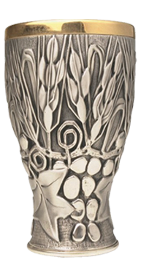
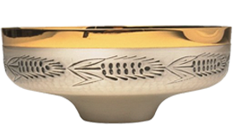
Take
Give Thanks
Break
Share

Slide 9
Take with thanks for God to transform
Give Thanks
Share
Share with love to know God’s blessing

Slide 10
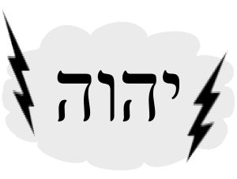
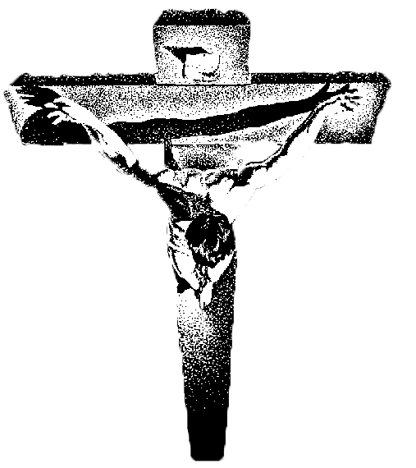
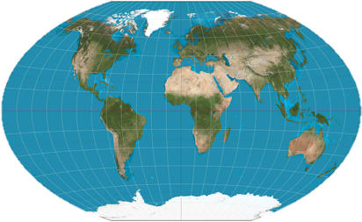
The world’s love for God offered by Christ
God’s love of the world through Christ
Worship
Mission

Slide 11
Joined with Christ’s
offering of love
to God
Joined with Christ’s
offering of love
to the world
Remembrance
Giving Thanks
Sharing
Praying

Slide 12
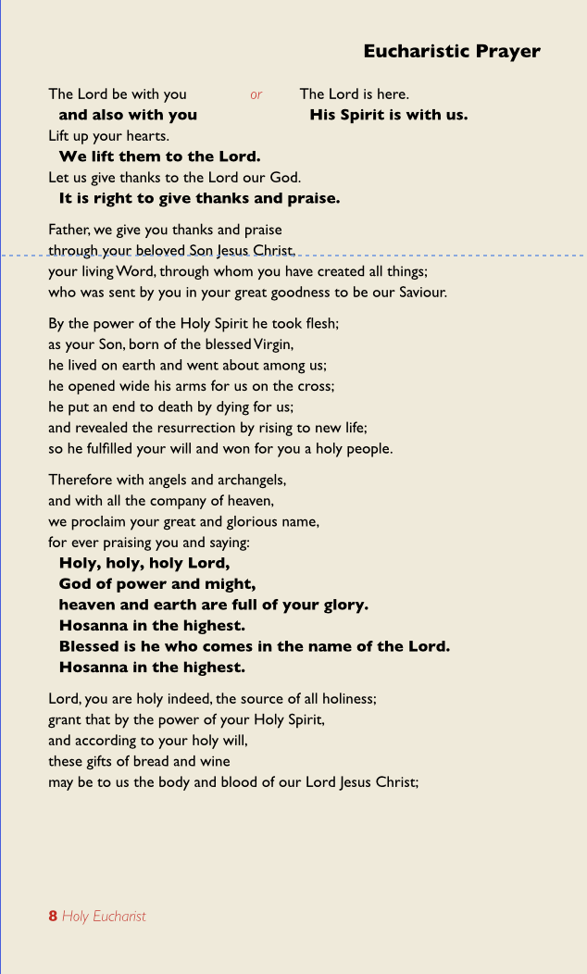
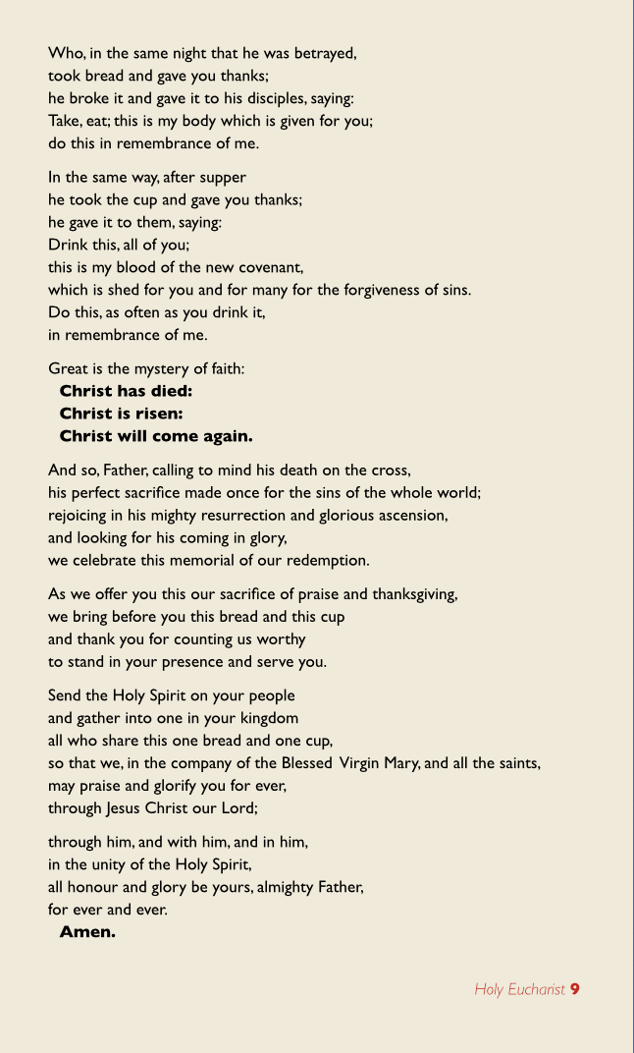
Remembrance
of what God has done in Christ
Prayer
For the Spirit’s present transformation
through our participation

Slide 13
GROUPS

Slide 14
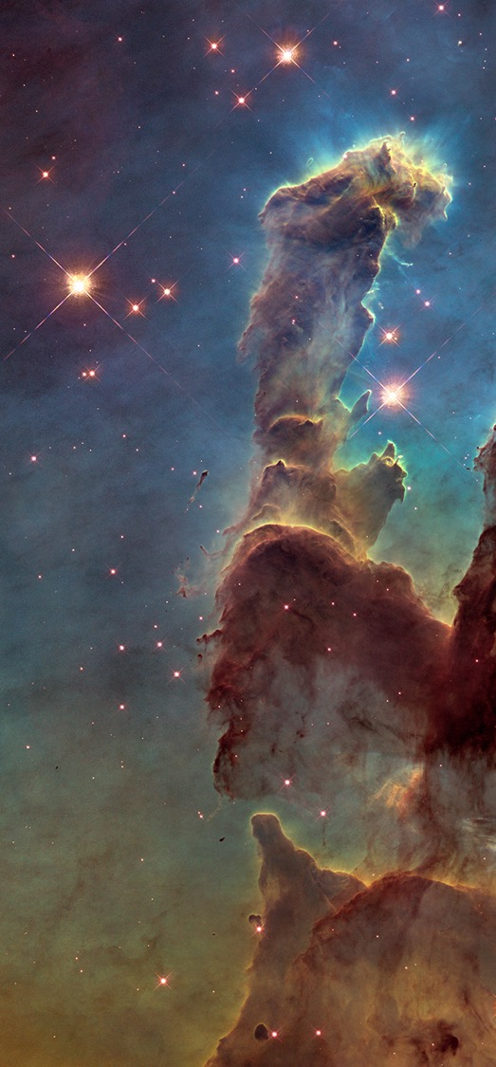
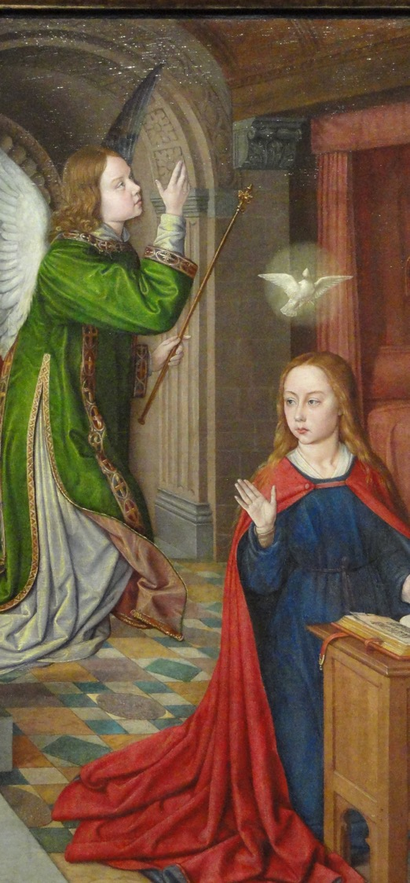
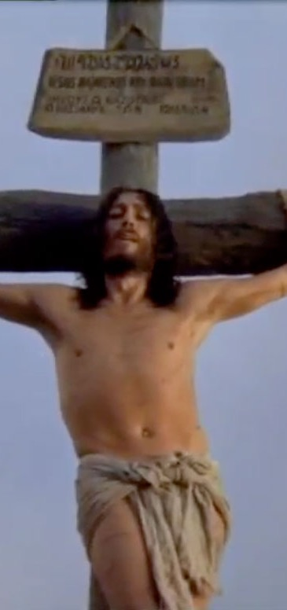
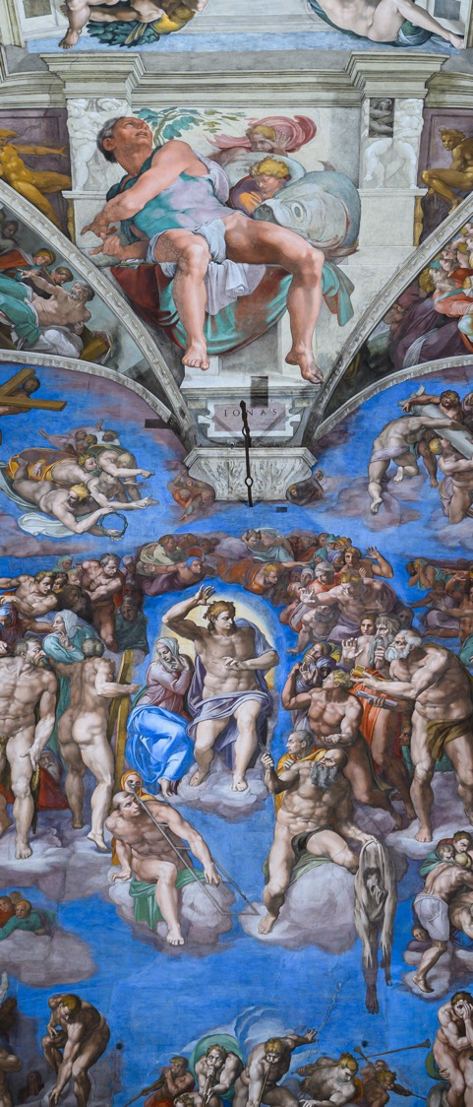

Slide 15
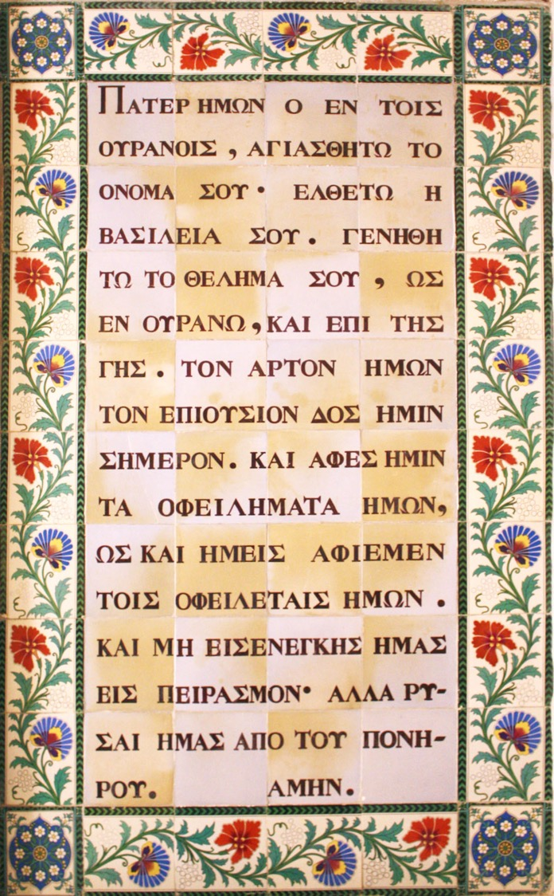
In relation to the Peace
Mt 6:14 “For if you forgive others
their trespasses, your heavenly
Father will also forgive you;”
In relation to the Communion
Mt 6:11 “Give us this day
our daily bread.”

Slide 16
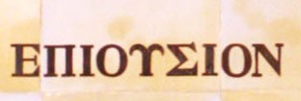
In relation to the Communion
Mt 6:11 “Give us this day
our daily bread.”

Slide 17
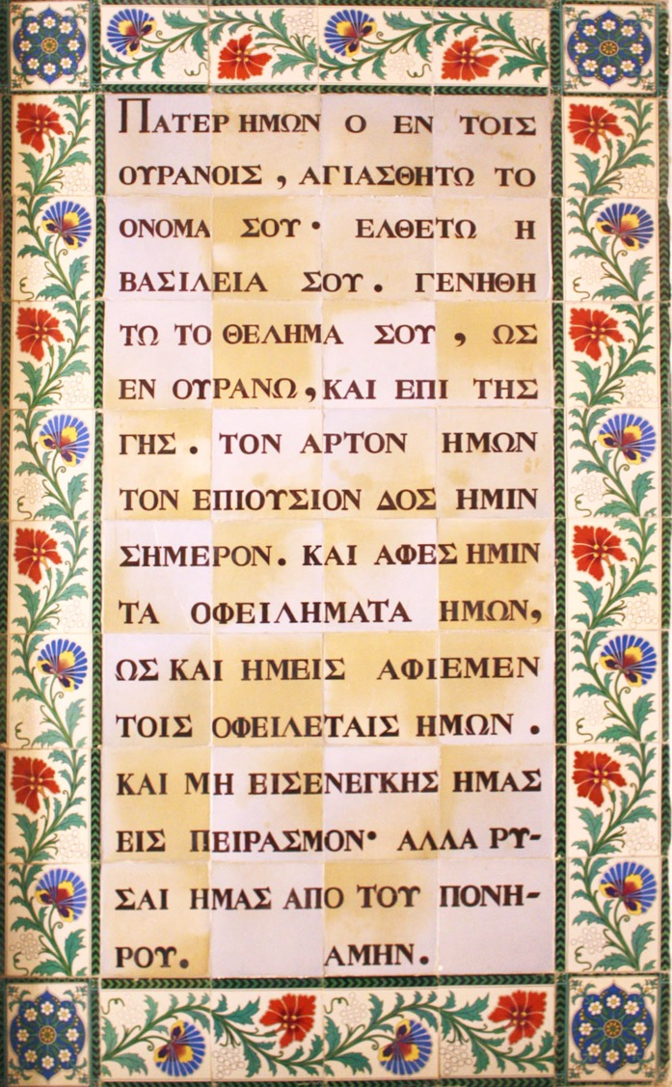
In relation to the Communion
Mt 6:11 “Give us this day
our daily bread.”
ἐπιούσιον
epiousion
Bread for the morrow
Bread for our spiritual selves

Slide 18
GROUPS

Slide 19
Deep peace of the running wave to you
Deep peace of the flowing air to you
Deep peace of the quiet earth to you
Deep peace of the shining stars to you
Deep peace of the gentle night to you
Moon and stars pour their healing light on you
Deep peace of Christ
Of Christ, Of Christ, the light of the world to you
Deep peace of Christ to you
The peace of the Lord be always with you
and also with you

