Slide 1

From
LITURGY to
LIFE
Holy Conversation

Slide 2
Lord, speak to us
that we may hear your word.
Move among us
that we may behold your glory.
Receive our prayers
that we may learn to trust you.
Amen.
Our Father in heaven …

Slide 3
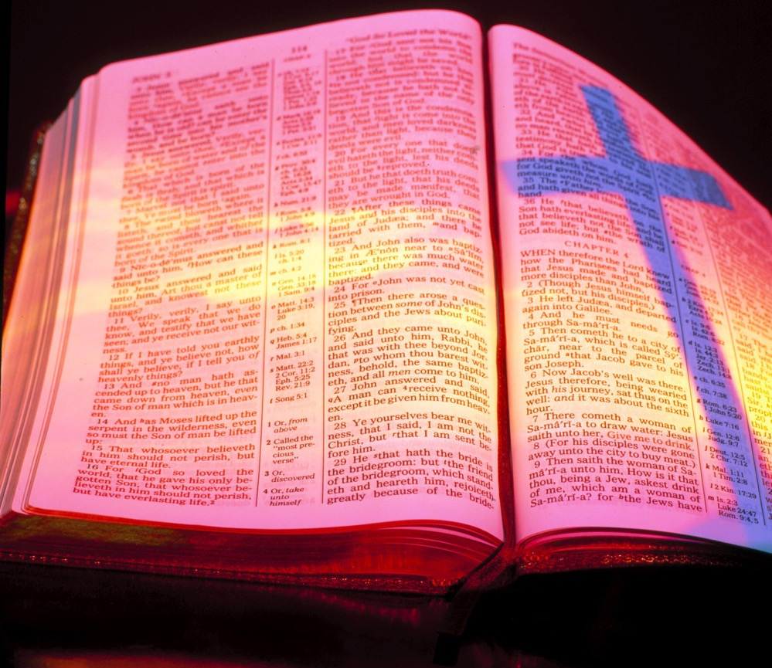


Slide 4
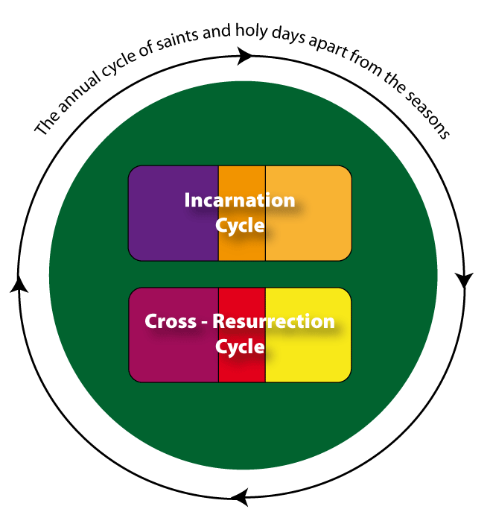


Slide 5
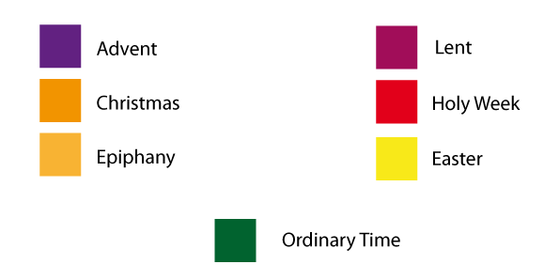

Slide 6
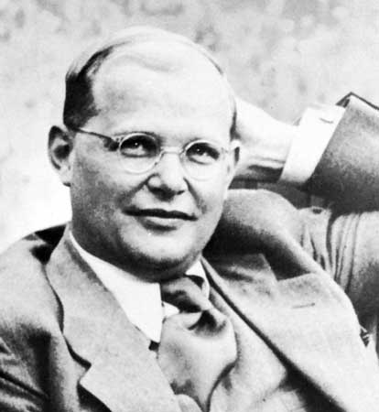
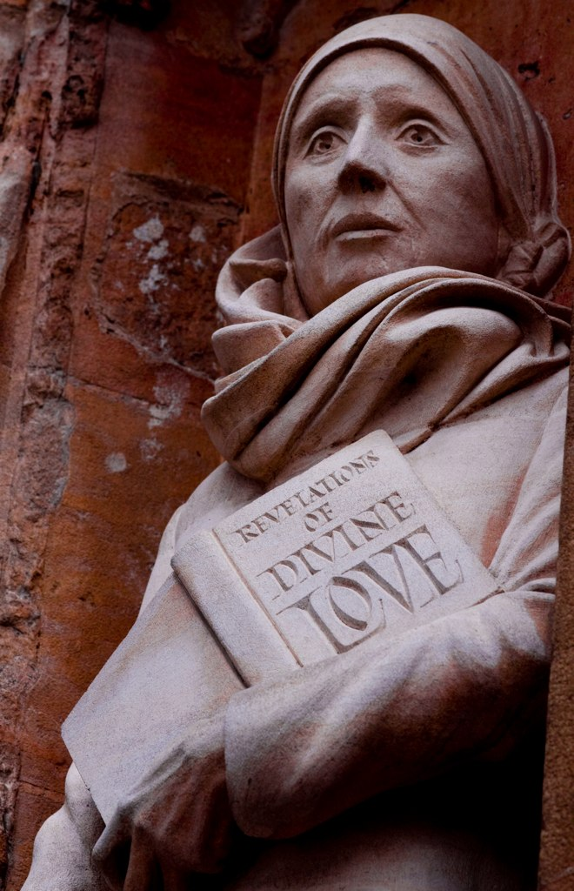
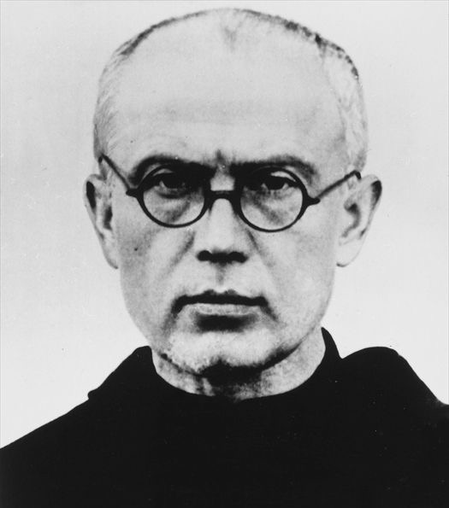

Slide 7
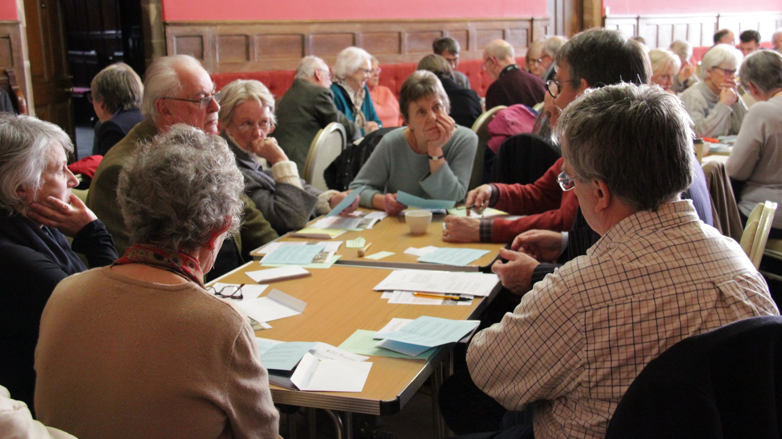
GROUPS

Slide 8
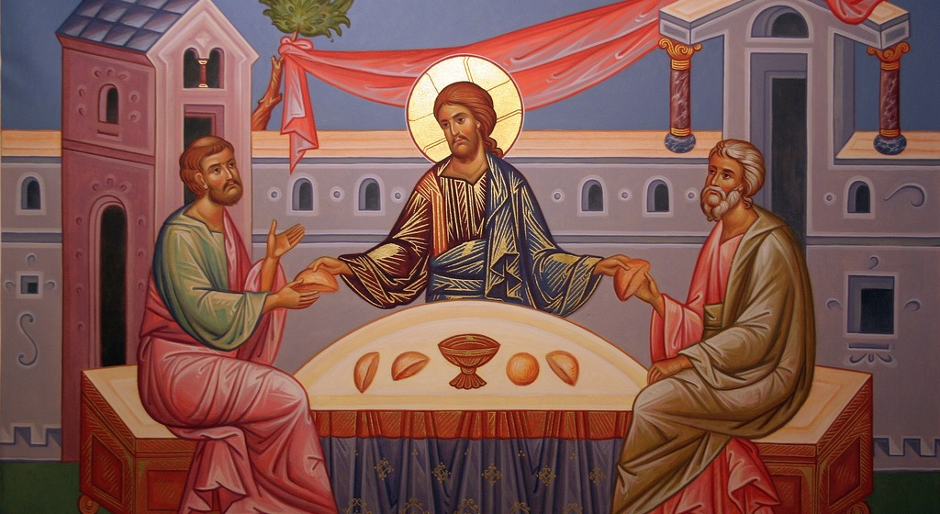

Slide 9
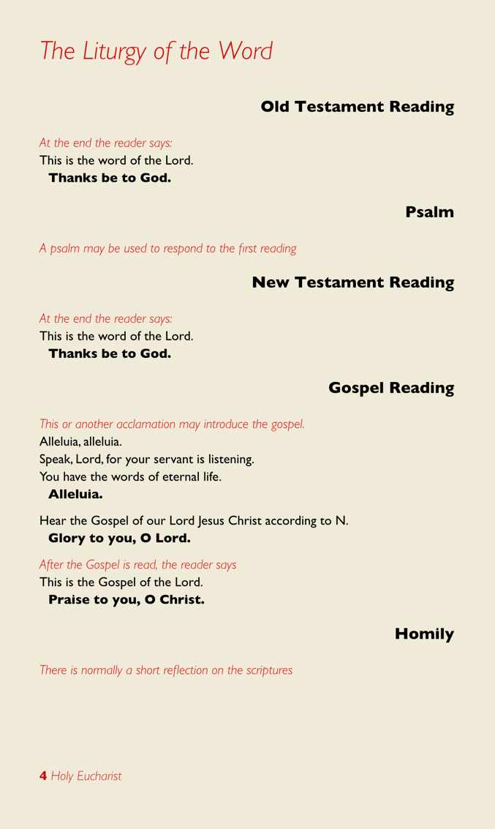
responds to
relates to
floats free

Slide 10


At the Eucharist
At Services of the Word

Slide 11
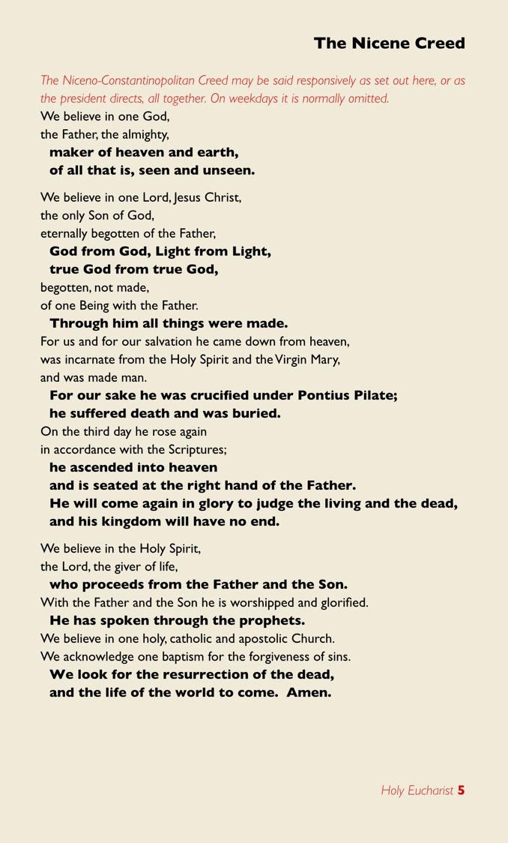
Some ways of thinking about the creed
It offers us a way of responding by recommitting ourselves to our faith.
It gives us a framework for reading the Bible
Like some psalms, rehearsing what God has done and who God is, is a form of praise.
The readings and sermon may have only focussed on one aspect of faith – the creed puts that into broader context.
It gives us a way of checking whether the preacher is a heretic!

Slide 12
GROUPS

Slide 13
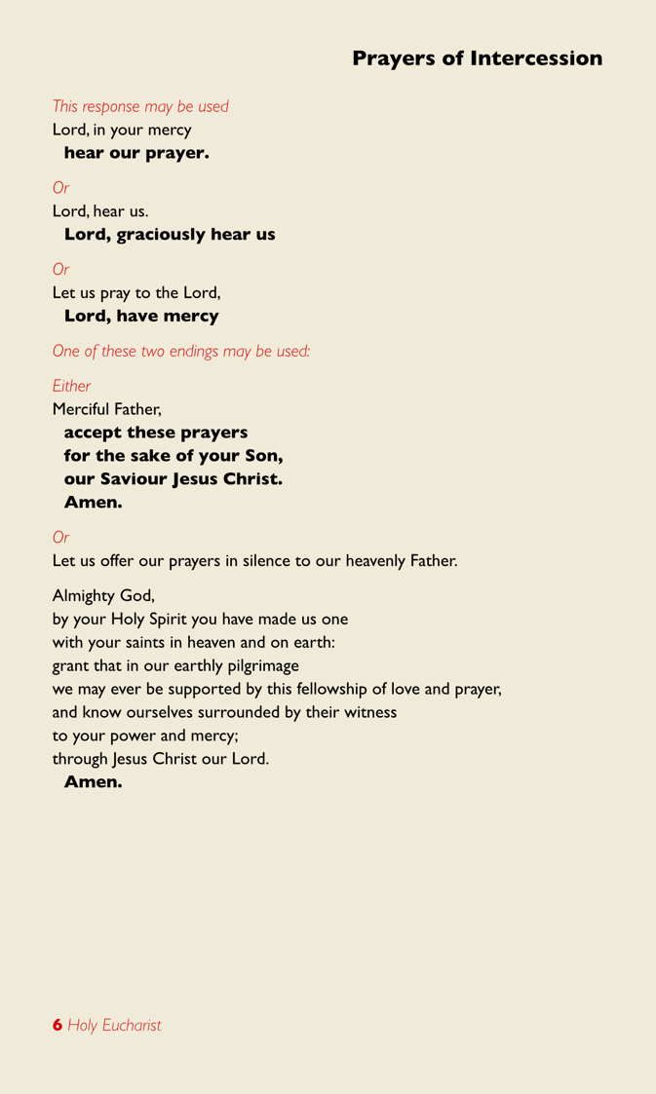
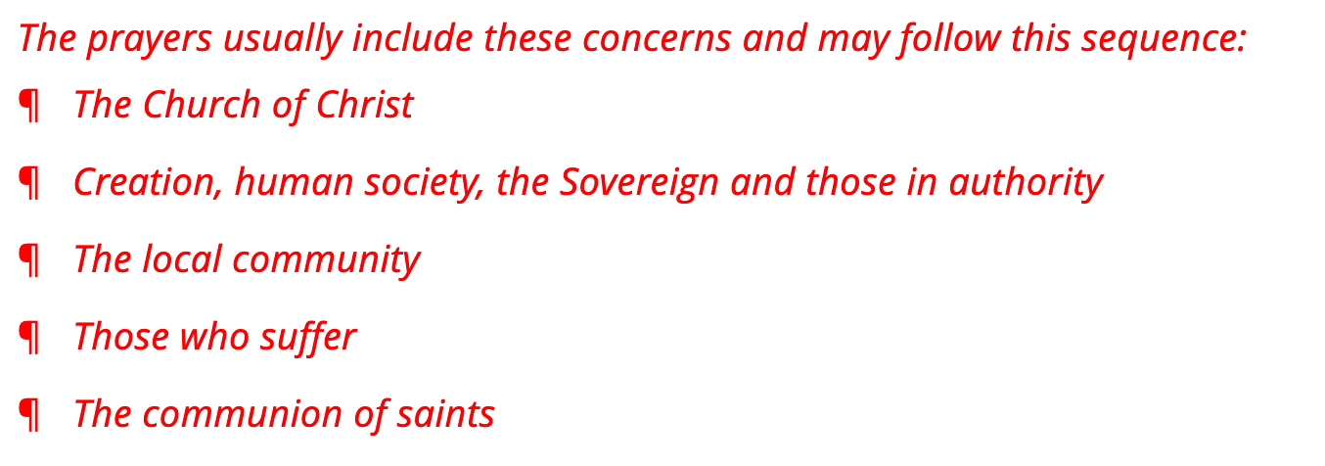
Alternative pattern
¶ World,
¶ Church
¶ Individuals in need

Slide 14

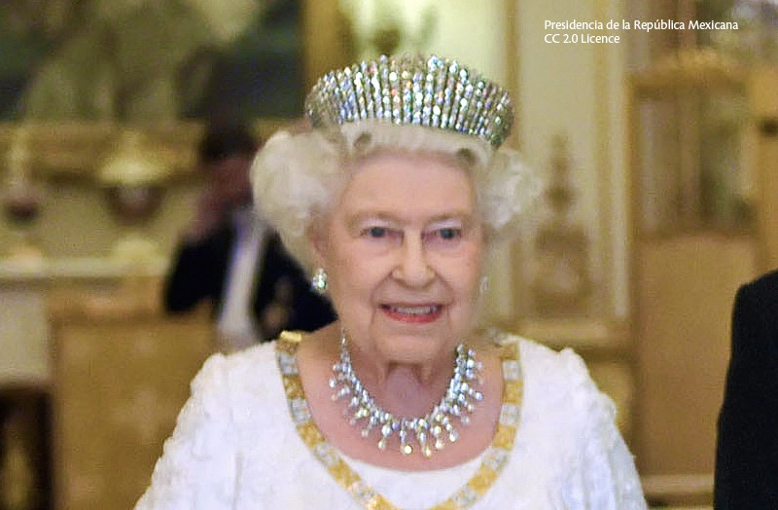
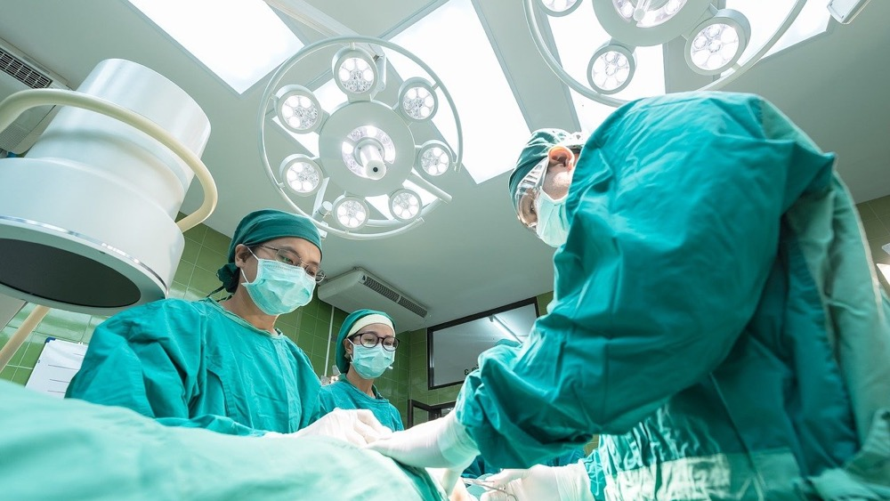
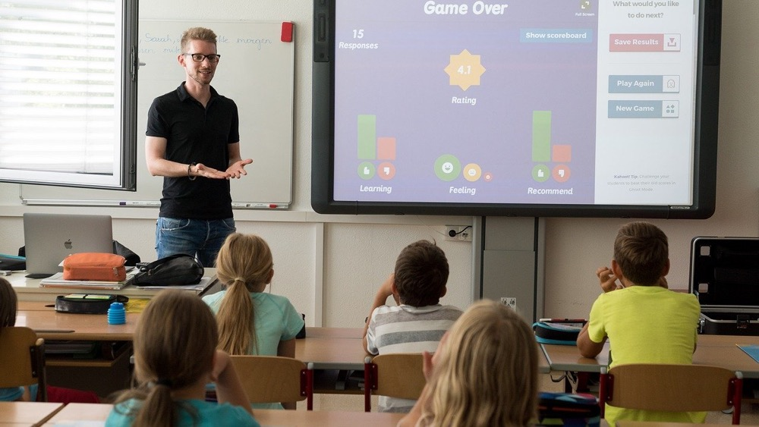

Slide 15


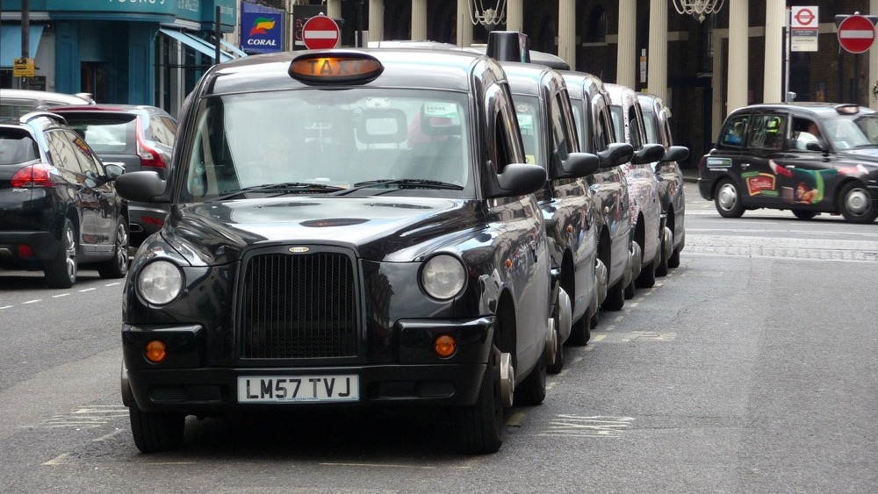
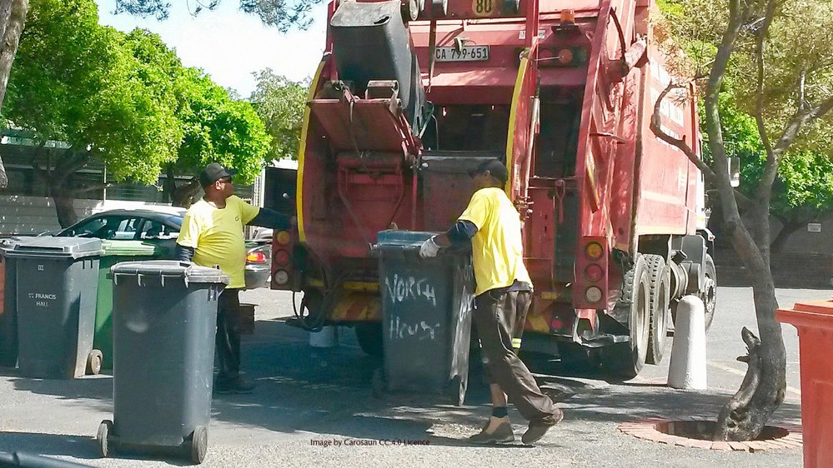

Slide 16
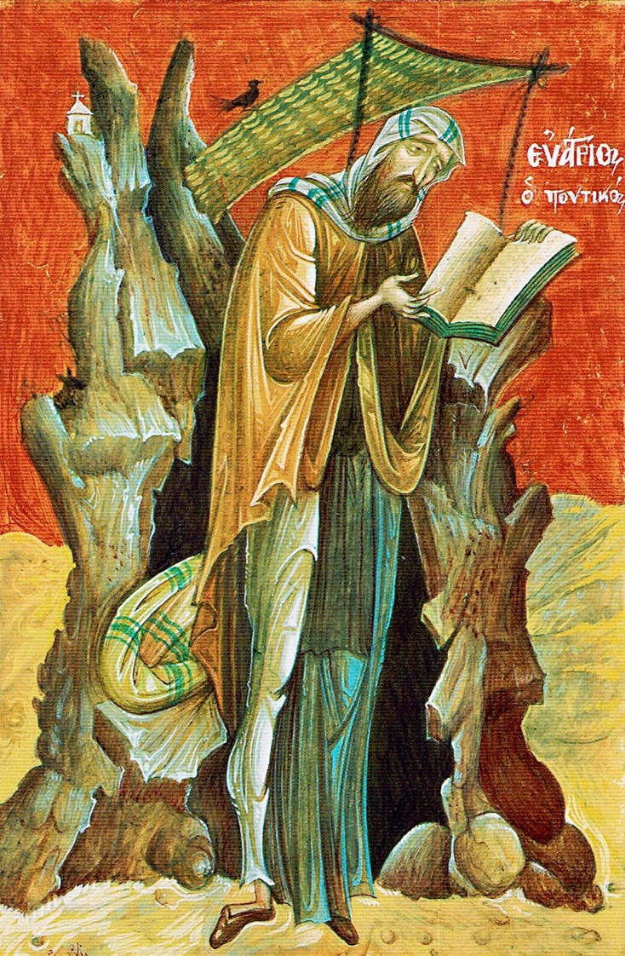
If you pray truly,
you are a theologian
St Evagrius of Pontus (d. 399)

Slide 17
GROUPS

Slide 18
Almighty God,
we thank you for the gift of your holy word.
May it be a lantern to our feet,
a light to our paths,
and a strength to our lives.
Take us and use us
to love and serve
in the power of the Holy Spirit
and in the name of your Son,
Jesus Christ our Lord.
Let us bless the Lord.
Thanks be to God.

