Slide 1

From
LITURGY to
LIFE
Invited into the life of God

Slide 2
Almighty God,
to whom all hearts are open,
all desires known,
and from whom no secrets are hidden:
cleanse the thoughts of our hearts
by the inspiration of your Holy Spirit,
that we may perfectly love you,
and worthily magnify your holy name;
through Christ our Lord. Amen.

Slide 3
In the course
Week 1: The Gathering – Invited into the life of God
Week 2: The Liturgy of the Word – Holy conversation
Week 3: The Liturgy of the Sacrament – Transformed with Christ
Week 4: The Dismissal – Blessed and blessing
How does what we pray help us think about how we live?

Slide 4
Invited into the life of God
In relationship – beginning with the Trinity, acknowledging one another
In three words – sorry, thanks, please
In our Father’s house – thinking afresh about repentance

Slide 5
In the name of the Father,
and of the Son,
and of the Holy Spirit. Amen.
… the blessing of God Almighty, the Father, the Son,
and of the Holy Spirit,
be with you, now and always. Amen

Slide 6
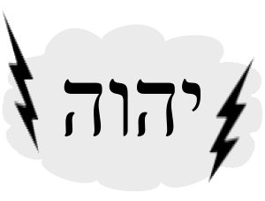


The world’s love for God offered by Christ
God’s love of the world through Christ

Slide 7
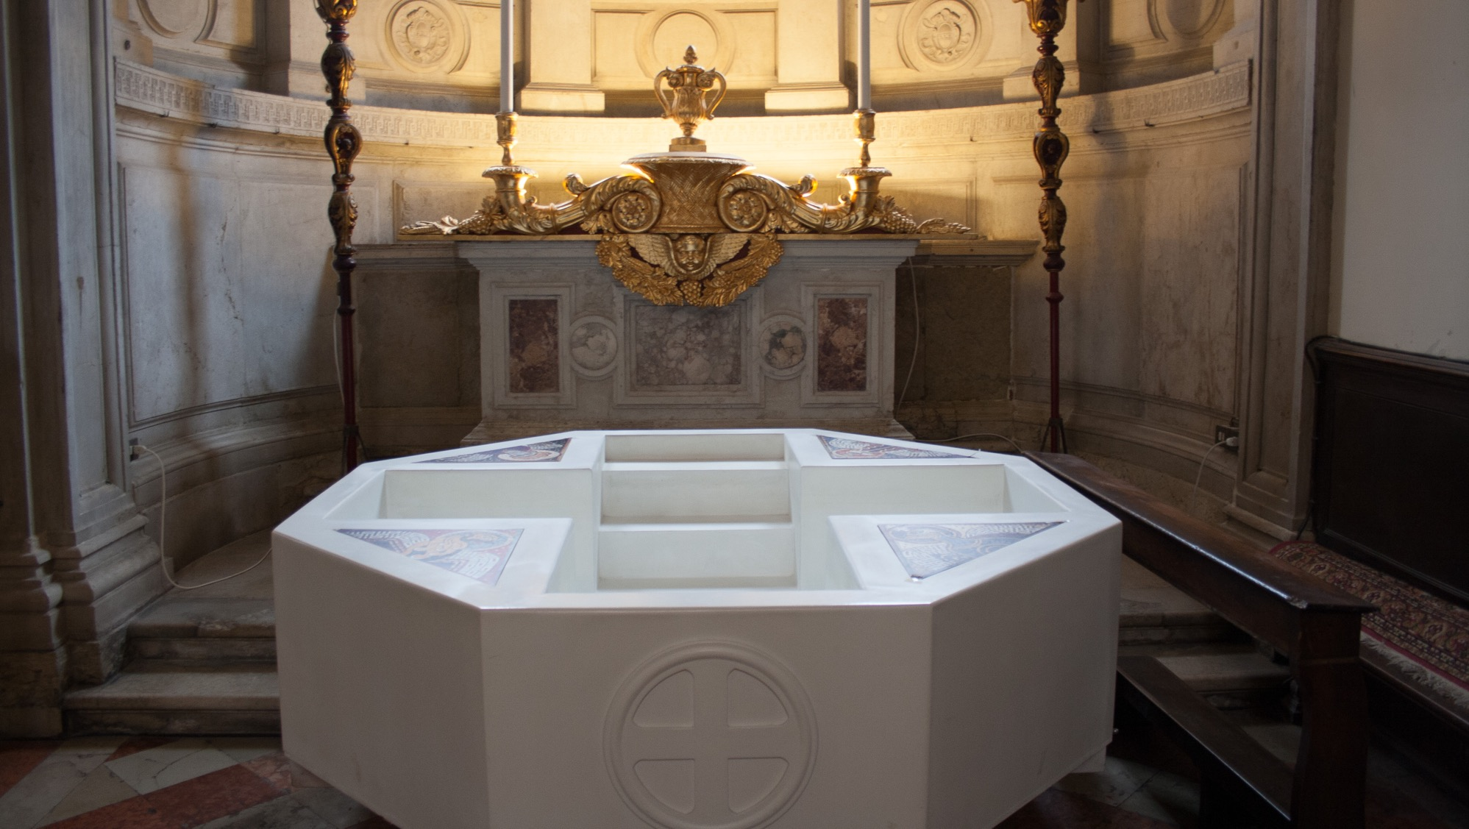

Slide 8
The world’s love for God offered by Christ
God’s love of the world through Christ
Worship
Mission

Slide 9
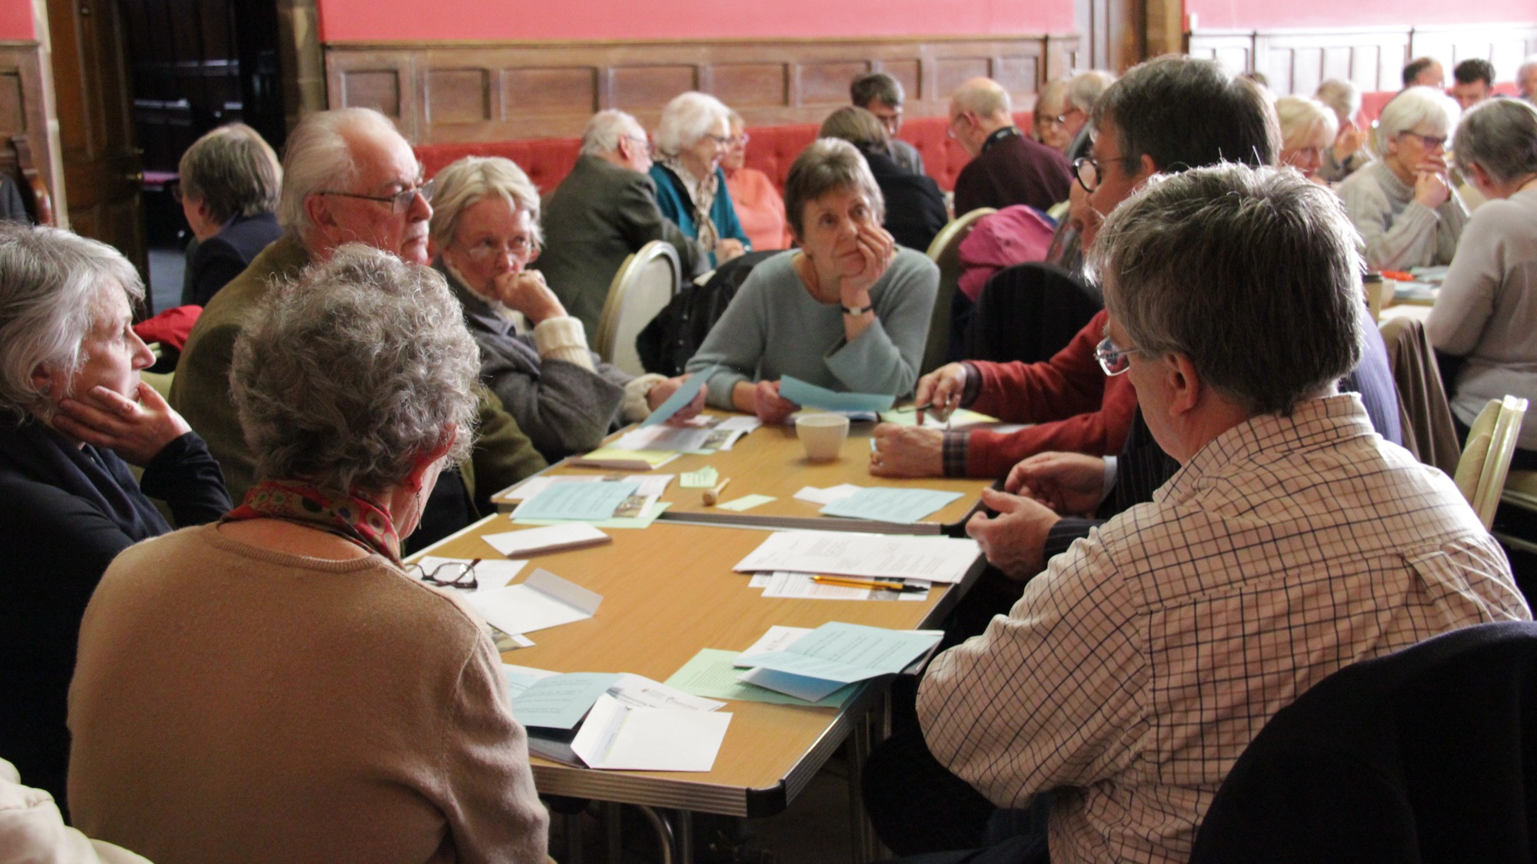
GROUPS

Slide 10
The world’s love for God offered by Christ
God’s love of the world through Christ
Worship
Mission

Slide 11
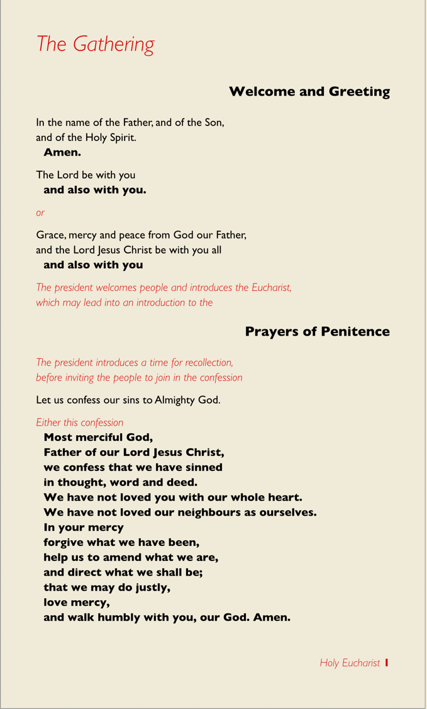
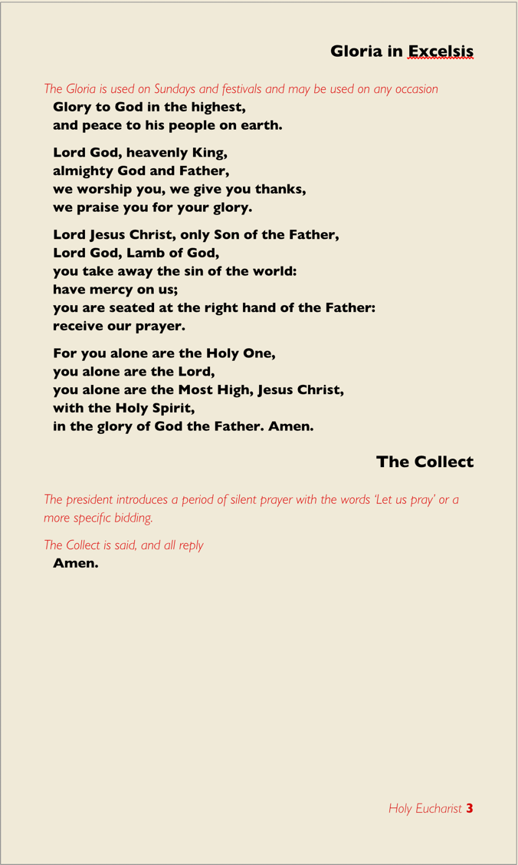
Three words
Thanks
Please
Sorry

Slide 12
Wow
Thanks
A fourth word?

Slide 13
Three (or 4) words
Wow
Thanks
Please
Sorry

Slide 14
GROUPS

Slide 15
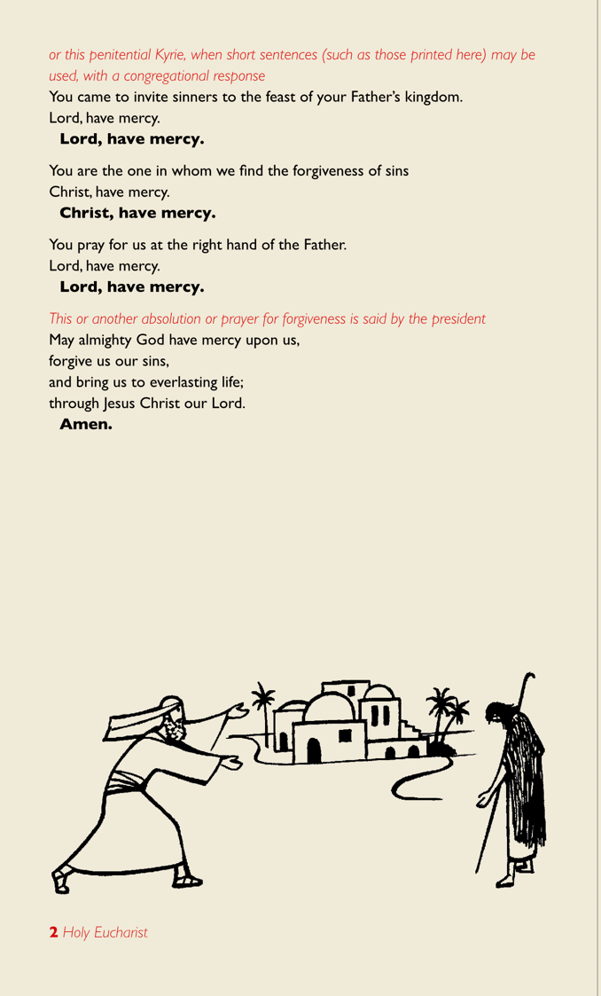
Why do the
prayers of penitence
come so early on?

Slide 16
Now all the tax collectors and sinners were coming near to listen to him. And the Pharisees and the scribes were grumbling and saying, “This fellow welcomes sinners and eats with them.”
So he told them this parable: “Which one of you, having a hundred sheep and losing one of them, does not leave the ninety-nine in the wilderness and go after the one that is lost until he finds it? When he has found it, he lays it on his shoulders and rejoices. And when he comes home, he calls together his friends and neighbours, saying to them, ‘Rejoice with me, for I have found my sheep that was lost.’ Just so, I tell you, there will be more joy in heaven over one sinner who repents than over ninety-nine righteous persons who need no repentance.

Slide 17
“Or what woman having ten silver coins, if she loses one of them, does not light a lamp, sweep the house, and search carefully until she finds it? When she has found it, she calls together her friends and neighbours, saying, ‘Rejoice with me, for I have found the coin that I had lost.’ Just so, I tell you, there is joy in the presence of the angels of God over one sinner who repents.”
Then Jesus said, “There was a man who had two sons. The younger of them said to his father, ‘Father, give me the share of the property that will belong to me.’ So he divided his property between them. A few days later the younger son gathered all he had and travelled to a distant country, and there he squandered his property in dissolute living. When he had spent everything, a severe famine took place throughout that country, and he began to be in need.

Slide 18
‘So he went and hired himself out to one of the citizens of that country, who sent him to his fields to feed the pigs. He would gladly have filled himself with the pods that the pigs were eating; and no one gave him anything. But when he came to himself he said, ‘How many of my father’s hired hands have bread enough and to spare, but here I am dying of hunger! I will get up and go to my father, and I will say to him, “Father, I have sinned against heaven and before you; I am no longer worthy to be called your son; treat me like one of your hired hands.” ’

Slide 19
So he set off and went to his father. But while he was still far off, his father saw him and was filled with compassion; he ran and put his arms around him and kissed him. Then the son said to him, ‘Father, I have sinned against heaven and before you; I am no longer worthy to be called your son.’ But the father said to his slaves, ‘Quickly, bring out a robe—the best one—and put it on him; put a ring on his finger and sandals on his feet. And get the fatted calf and kill it, and let us eat and celebrate; for this son of mine was dead and is alive again; he was lost and is found!’ And they began to celebrate.
(Luke 15:1-24)

Slide 20
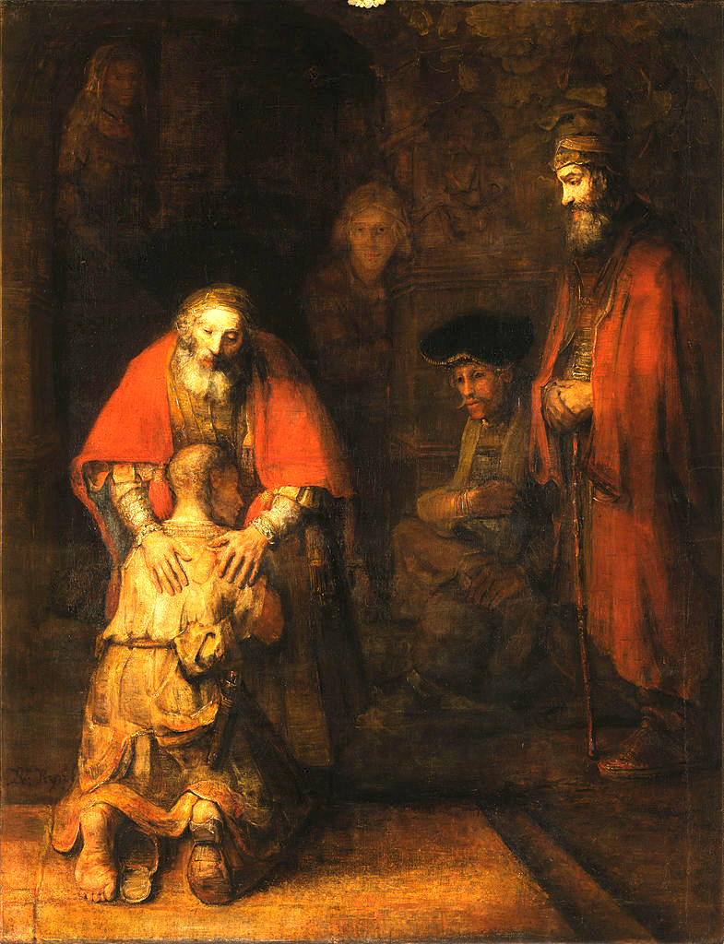

Slide 21
GROUPS

