Slide 1
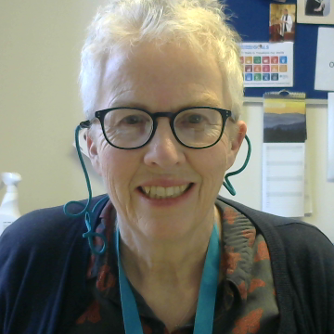
Living in Love and Faith General Synod February 2025
Lynn Nichol, Lay Representative Diocese of Worcester
Notes:
Good morning, I’m Lynn Nichol and I’m one of the lay representative for Worcester Diocese for General Synod. I’m really sorry I can’t be at Diocesan Synod in person, but I have a long standing family commitment today. Before I start I realise that living in love and faith and prayers of love of faith are a very personal issue for many people and I’m sure there are diverse views in the room. I will keep my comments to a factural report around what was presented at Synod and I’m sure others who were there will be able to support you/answer questions either after the presentation or during the day.

Slide 2
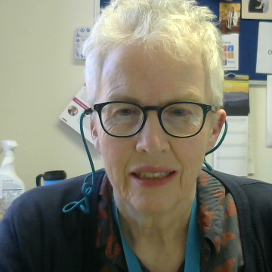
LIVING IN LOVE AND FAITH: UPDATE ON PROPOSALS
‘Can we imagine a future together? One church with all our differences, or are we resigned to go our separate ways, mirroring wider society where each one chooses their own truth’?
Notes:
There was no debate at General Synod in February about LLF, Martin Snow Bishop of Leicester and Lead Bishop for the LLF process gave a presentation and there was then an opportunity for members of Synod to ask questions. I’ll speak briefly about the presentation and then give some of the questions and answers provided. He opened his presentation with a question – can we imagine a future together? One church with all our differences, or are we resigned to go our separate way, mirroring wider society where each one chooses their own truth?

Slide 3
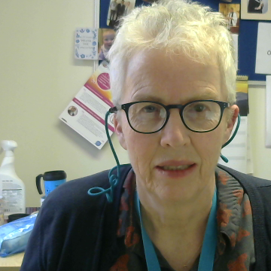
LIVING IN LOVE AND FAITH: UPDATE ON PROPOSALS
Outlined ongoing work – shared episcopacy and congregations and clergy remaining in communion even if they disagree.
Based on offering bespoke prayers for those in same sex relationships and devolved episcopal ministry for those who are unable to work in that situation.
Alongside - important theological work is being undertaken considering clergy who wish to enter same sex civil marriage.
He apologised that the timetable had slipped on this.
Notes:
He Outlined ongoing work – based on shared episcopacy and congregations and clergy remaining in communion even if they disagree.
This would be based on offering bespoke prayers for those in same sex relationships and devolved episcopal ministry for those who are unable to work with that situation. Along side this important theologial work is being undertaken considering clergy who wish to enter same sex civial marriage

Slide 4
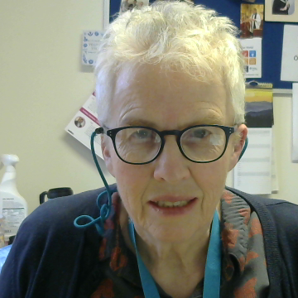
Questions and Answers
1. Will proposals come back to General Synod at the latest by Feb 2026 to give certainty when LGBTQ+ people may or may not be able to celebrate their love in church? - The Bishop of Leicester was committed to this but can’t be certain.
2. What resources can be provided for GS members and to Diocesan Synod to enable discussions in Diocese, eg what happens in multi-parish benefices, what if incumbent and PCC disagreed? - Resource Materials will be provided in March and a rolling update provided over the next 6-9 months.
3. Will there be more information for Diocesan Synods on how to make sure the discussions are safe in Diocesan Synod?– guidance will be provided including the document from LLF resources ‘braver and safer’ will be part of resources provided.
4. What should clergy say to good Christians offering themselves for ordination and are already in same sex marriages – should they get divorced? – there is a working group on this area with new guidance available this year.
Notes:
I’ll talk through 6 questions which are indicative of the areas of questions posed by the members of synod. Is it possible to be clear on timing that proposals will come back to Synod at the latest by Feb 2026 to give certainty when LGBTQ+ people may or may not be able to celebrate their love in church? - The Bishop of Leicester was committed to this but can’t be certain.
2. What resources can be provided for GS members and to Diocesan Synod to enable discussions in Diocese, eg what happens in multi-parish benefices, what if incumbent and PCC disagreed? - Resource Materials will be provided by the beginning of March and a rolling update provided over next 6-9 months. There will also be guidance on the context of multi-parish benefices.
Will there be more information for Diocesan Synods on how to make sure the discussions are safe in Diocesan Synod?– the document from LLF resources ‘braver and safer’ will be part of resources provided.
3. What should clergy say to good Christians offering themselves for ordination and are already in same sex marriages – should they get divorced? – there is a working group on this area with new guidance available this year.

Slide 5
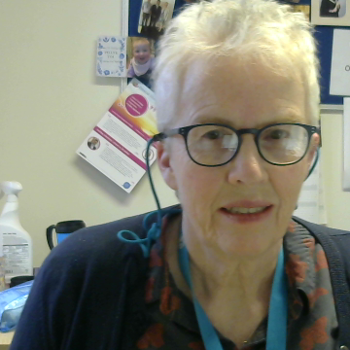
Questions and Answers
5. What reassurance can you give that alternative episcopal oversight will not be a post code lottery? The possible Devolved Episcopal Ministry (only an idea not final proposal) is a national framework and needs to be sufficient for those who need it and needs to be part of the consultation with Dioceses.
6. What can we pray for? – that that these are healthy conversations about where God is leading us as a church.
Notes:
And the final two questions.

Slide 6
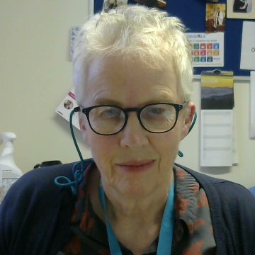
Next steps
LLF team will continue to work on proposals and theological work that will be brought to future meetings of General Synod
Diocesan Synods will be consulted before July 2025 General Synod Meeting
Thank you for listening!

